Slide 1
Memory Management
Dr. Nicola Bicocchi

Slide 2
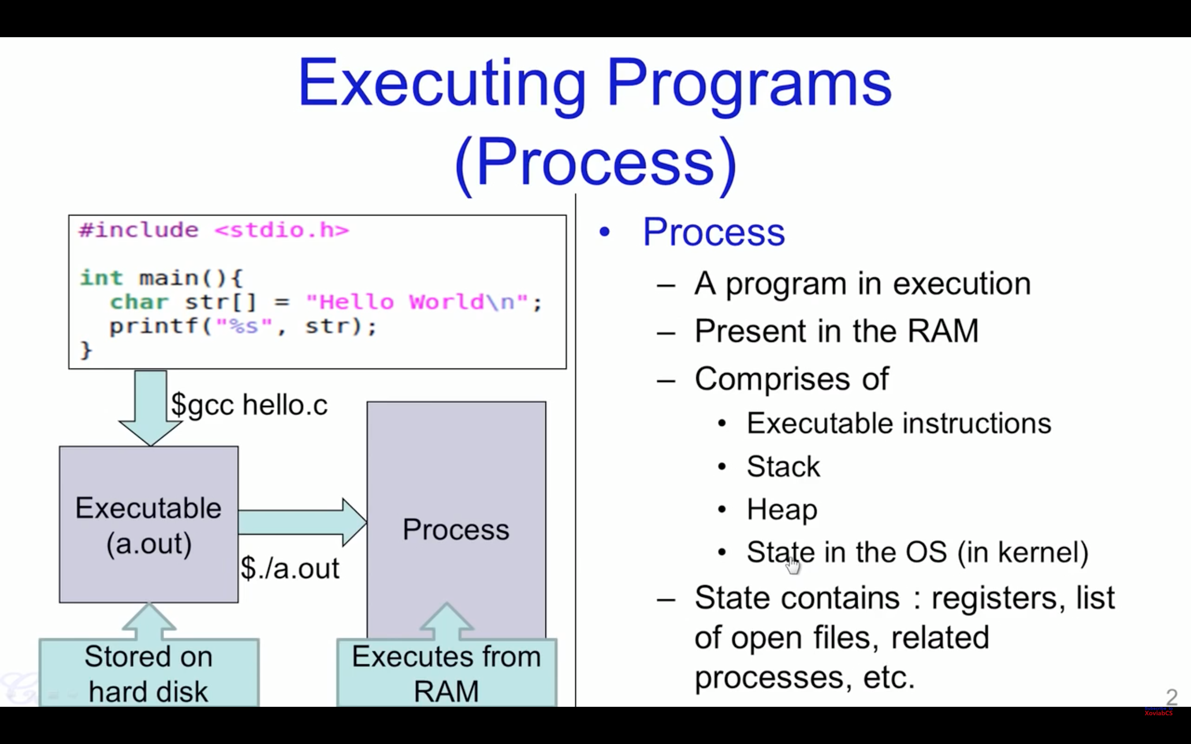

Slide 3
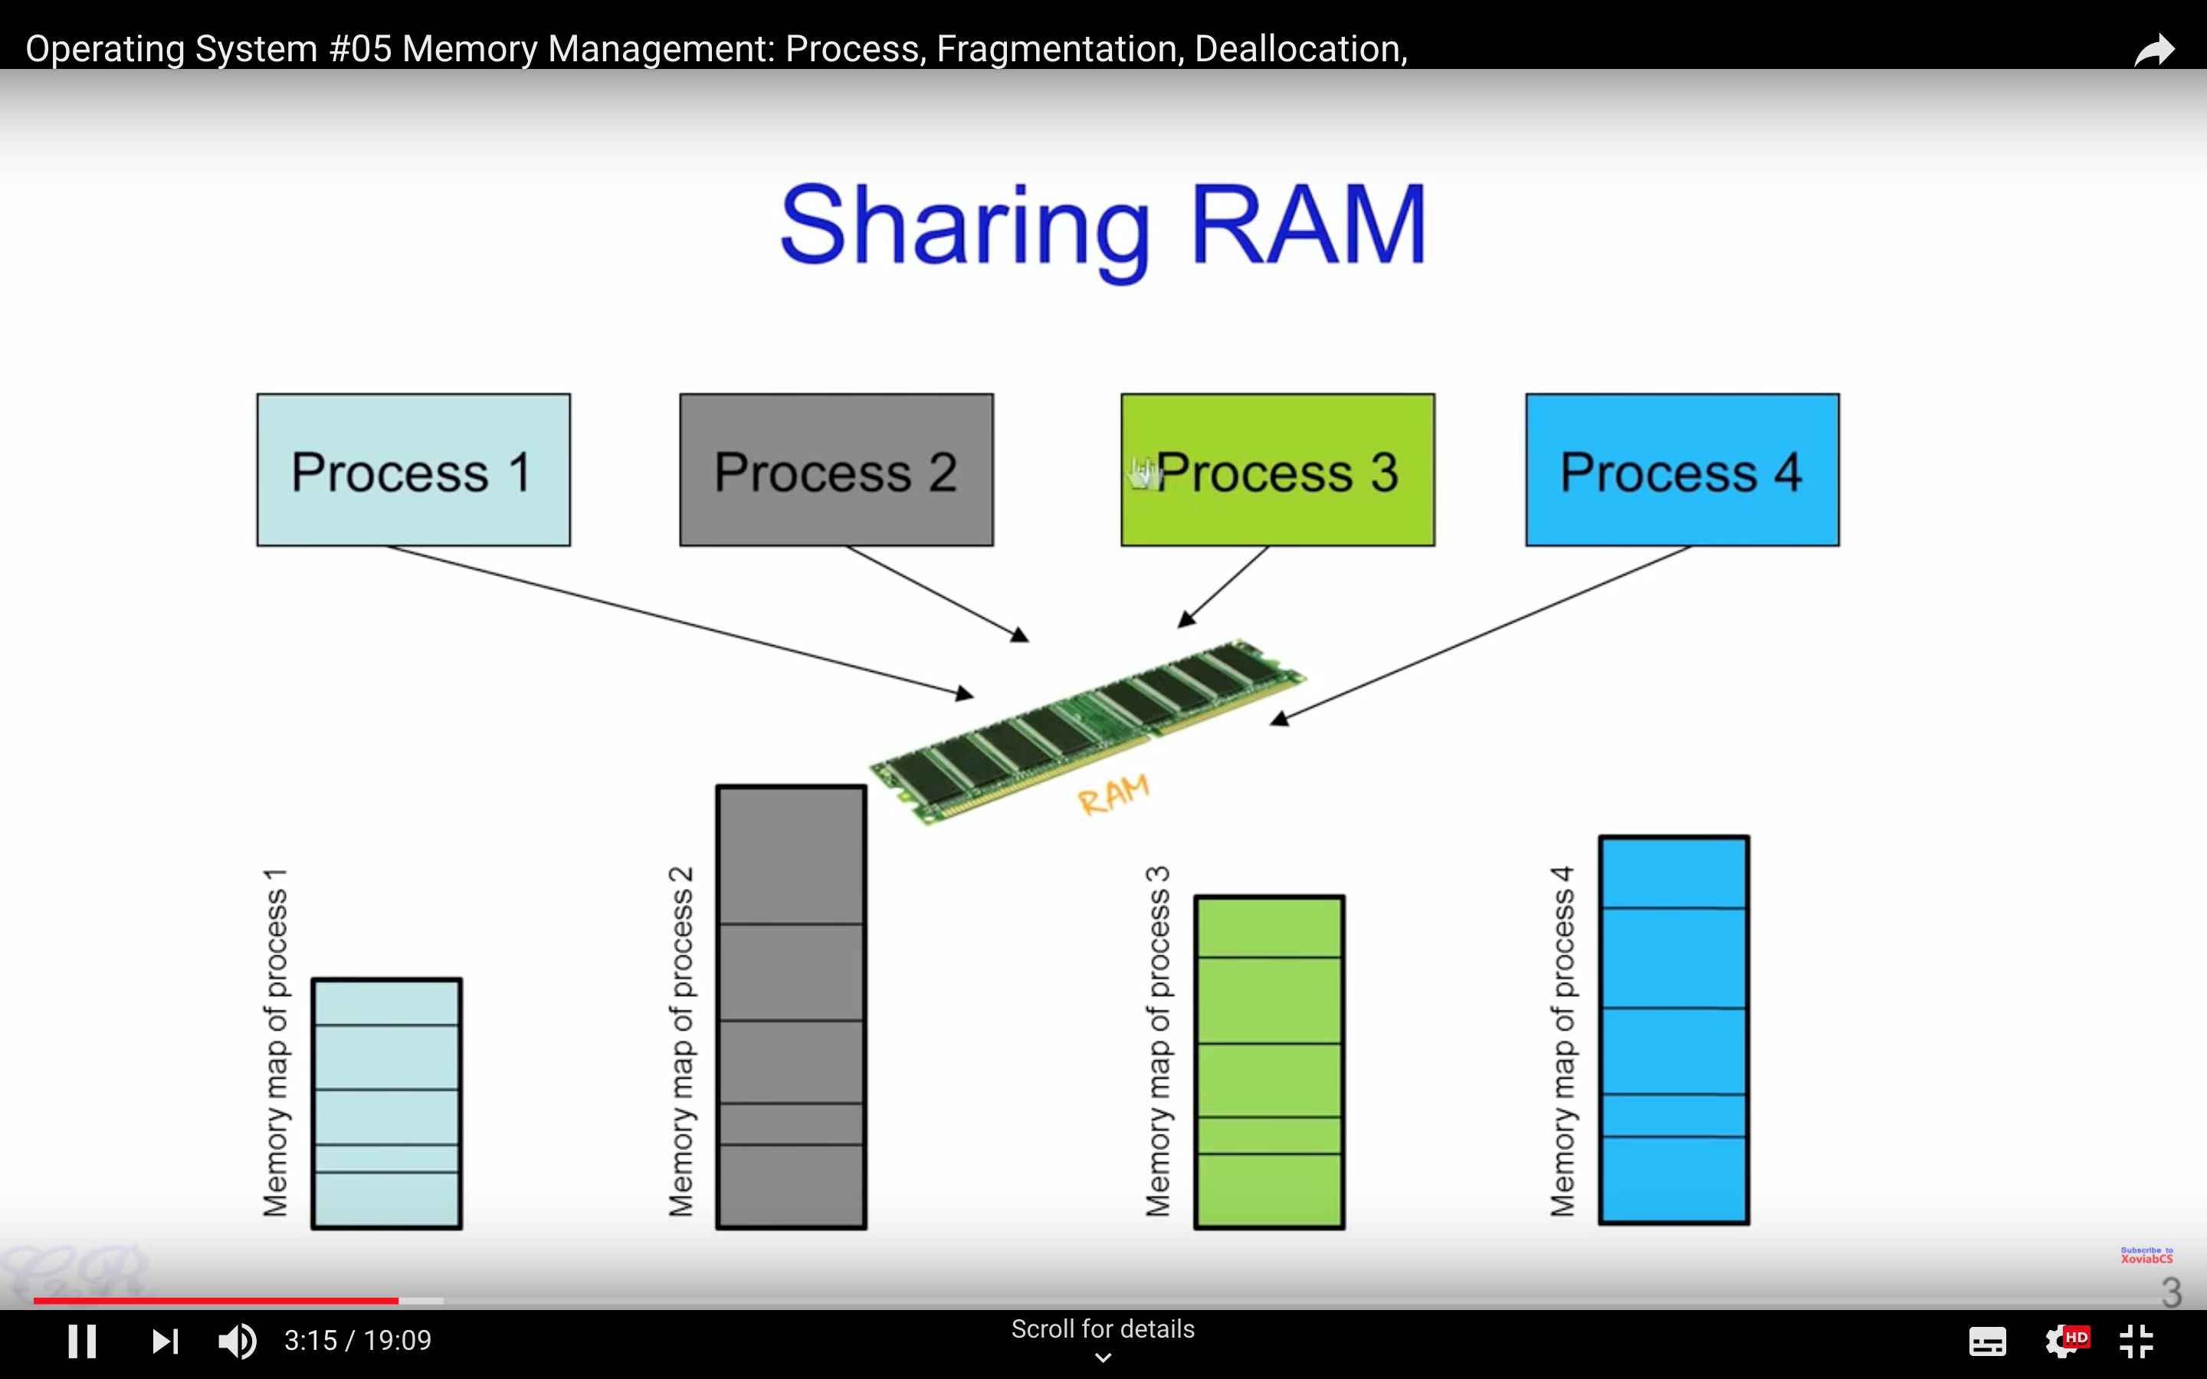

Slide 4
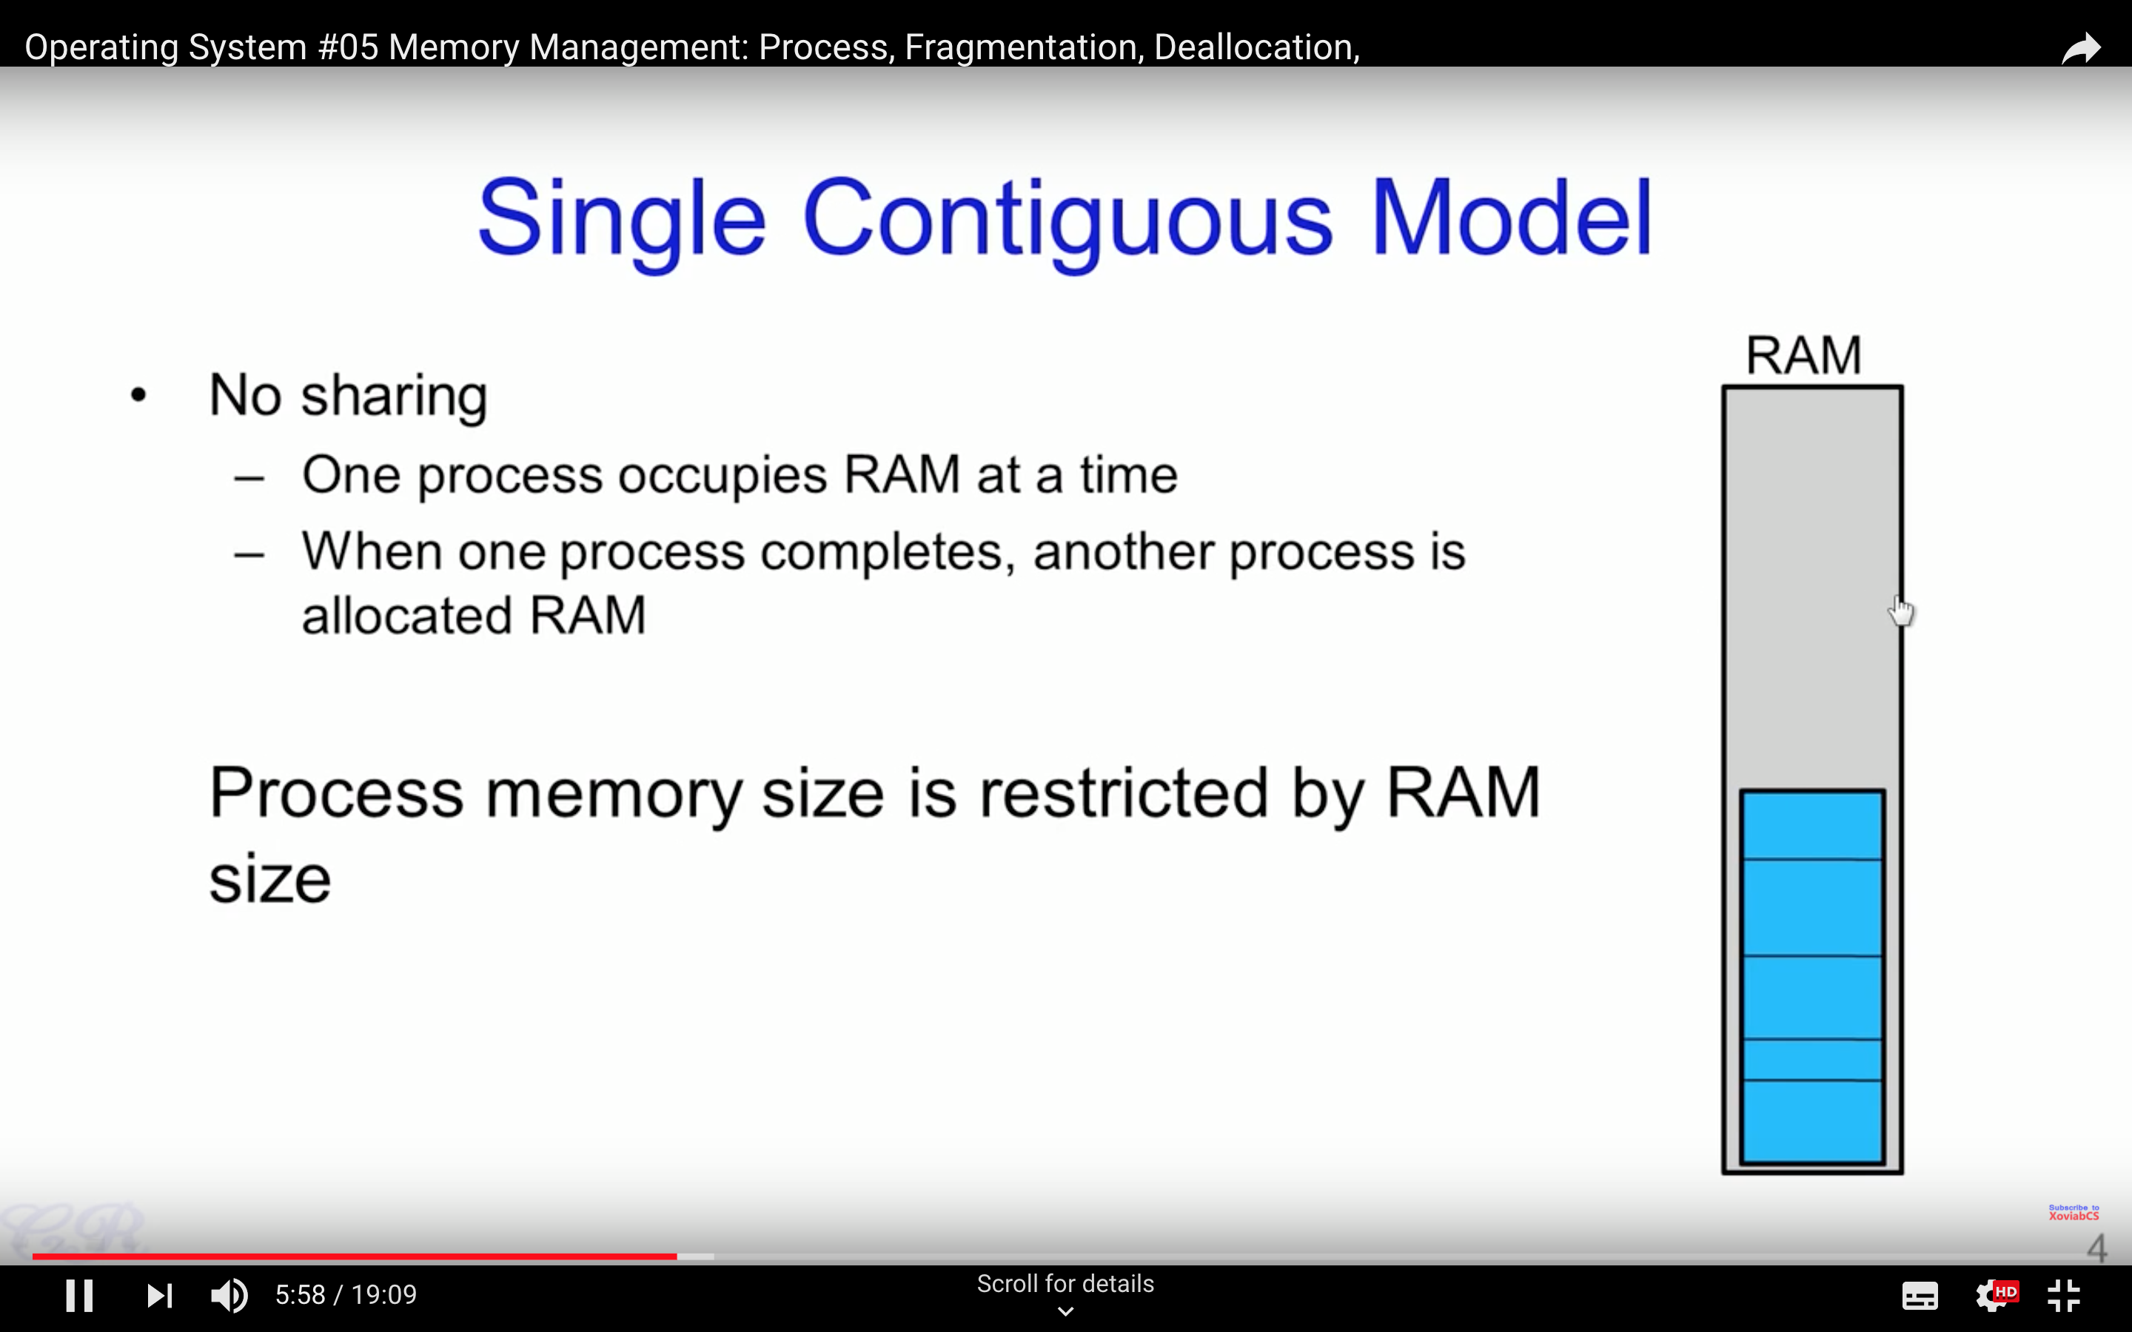

Slide 5
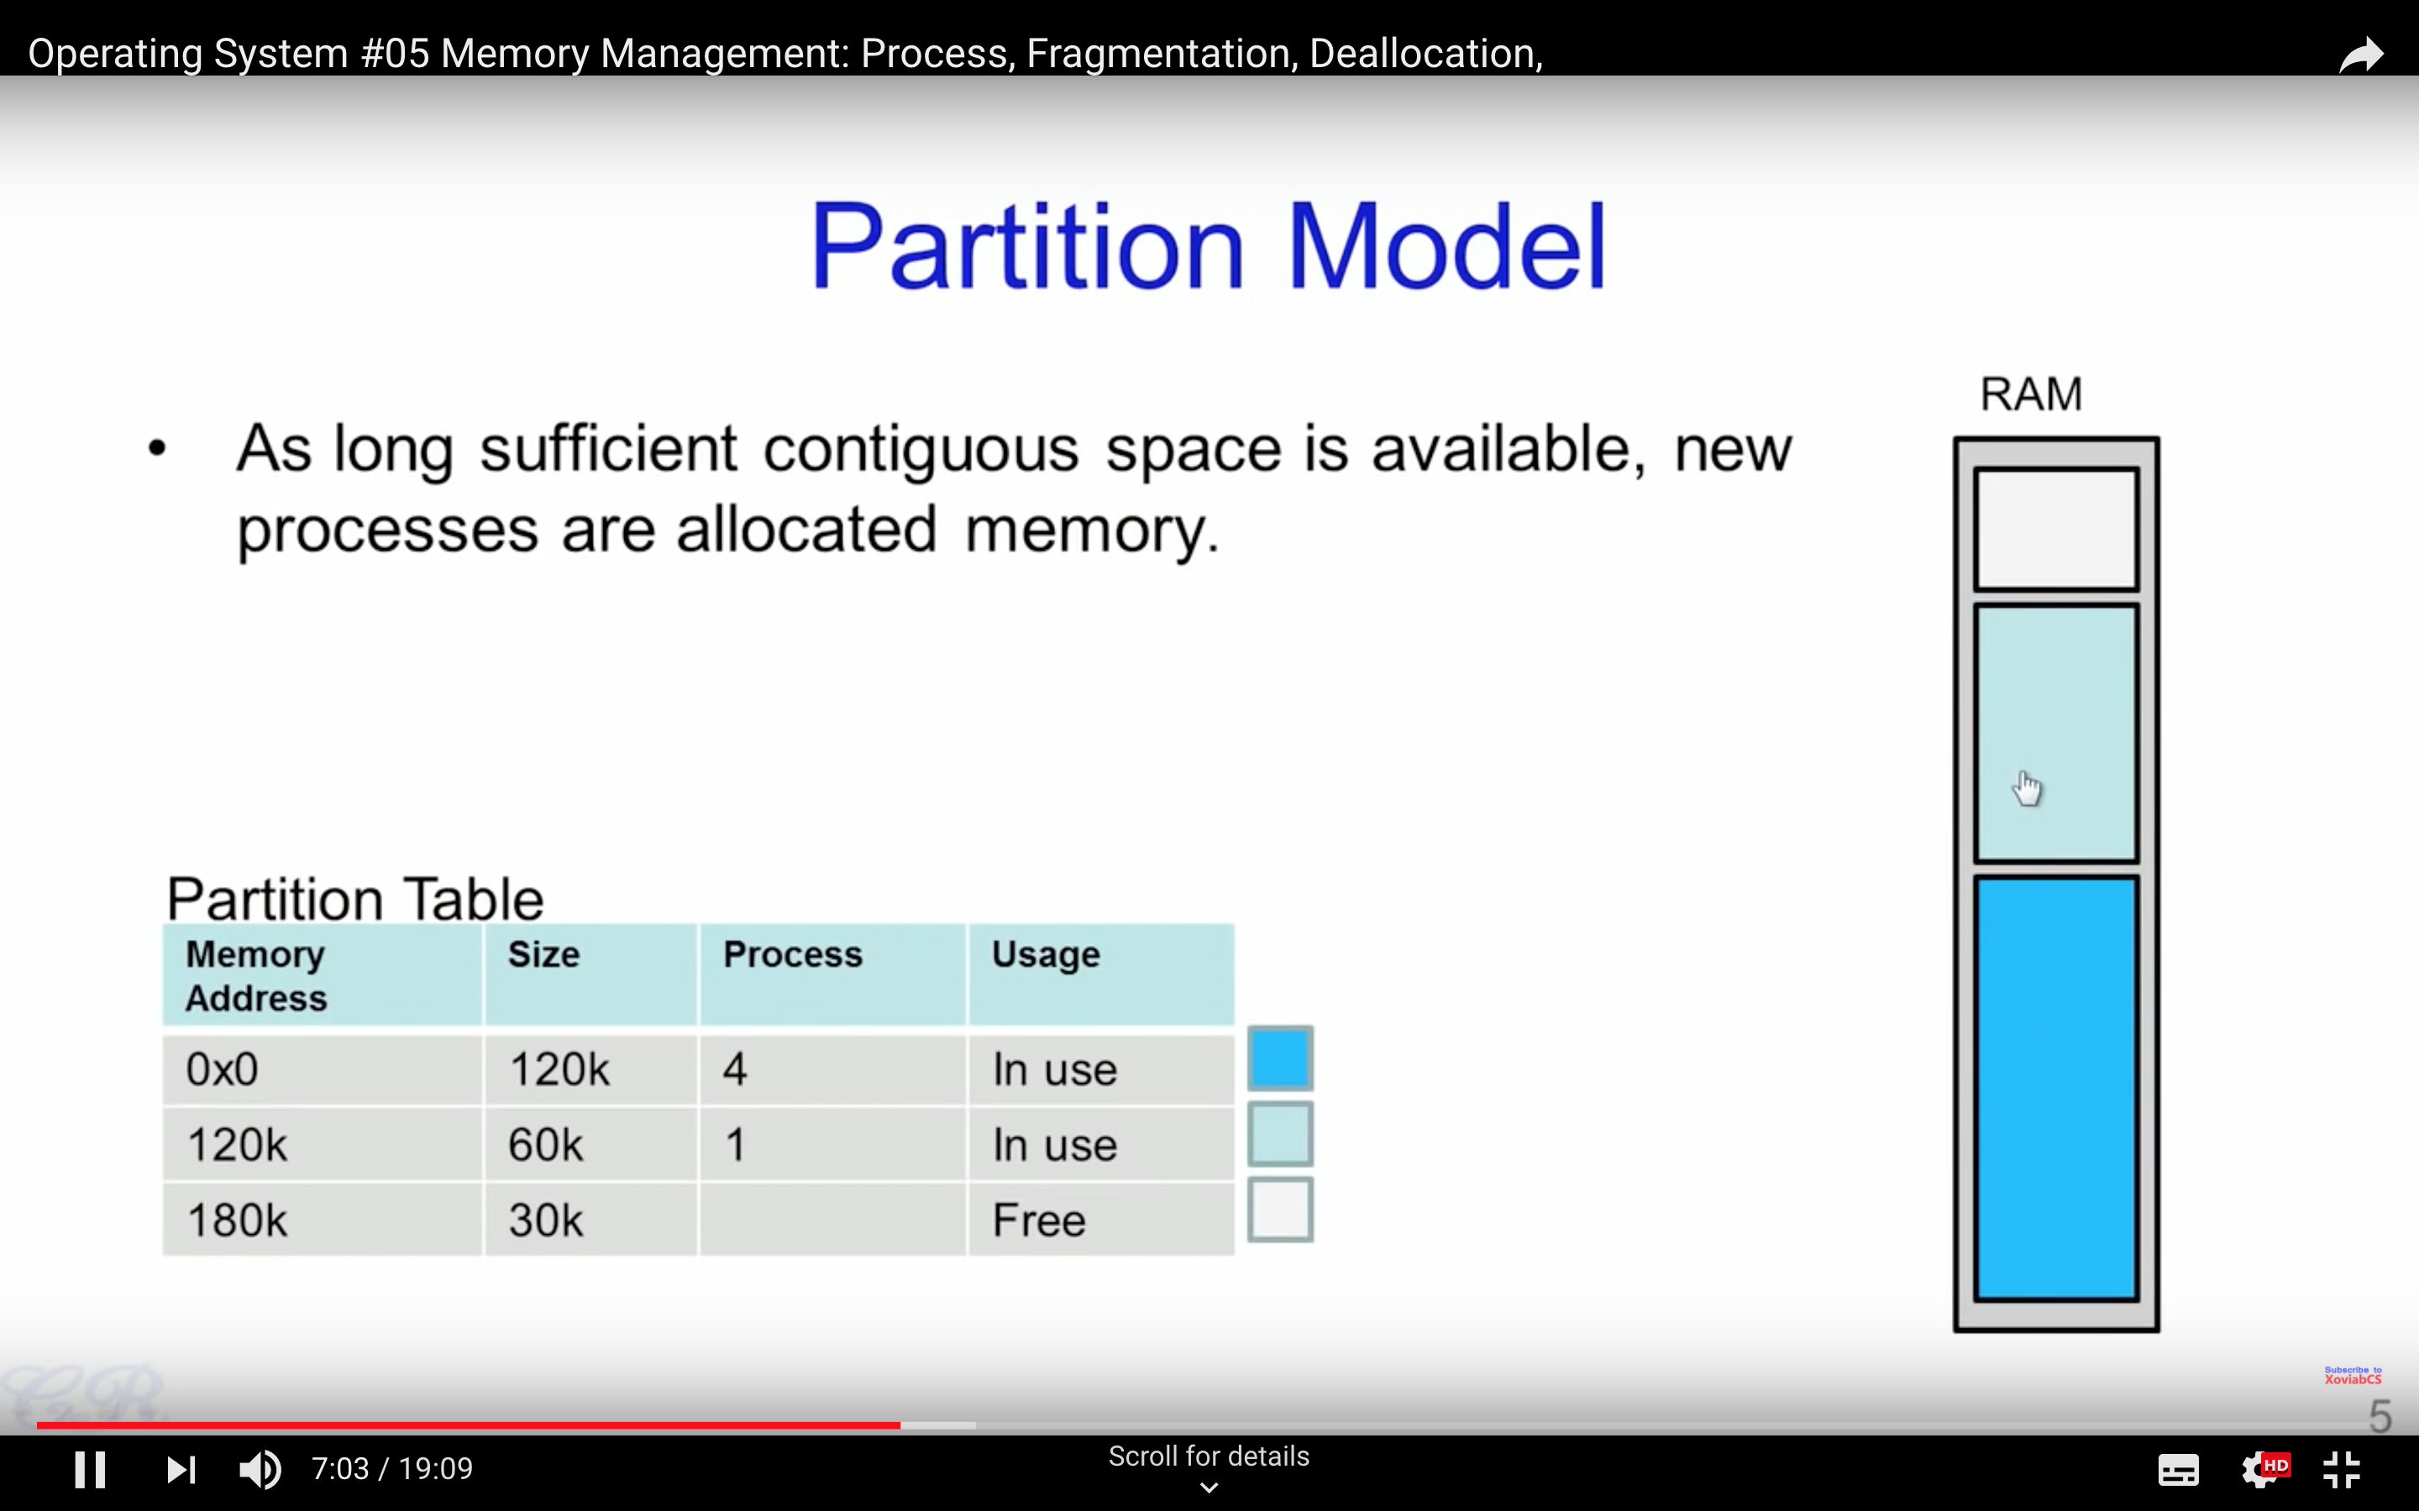

Slide 6
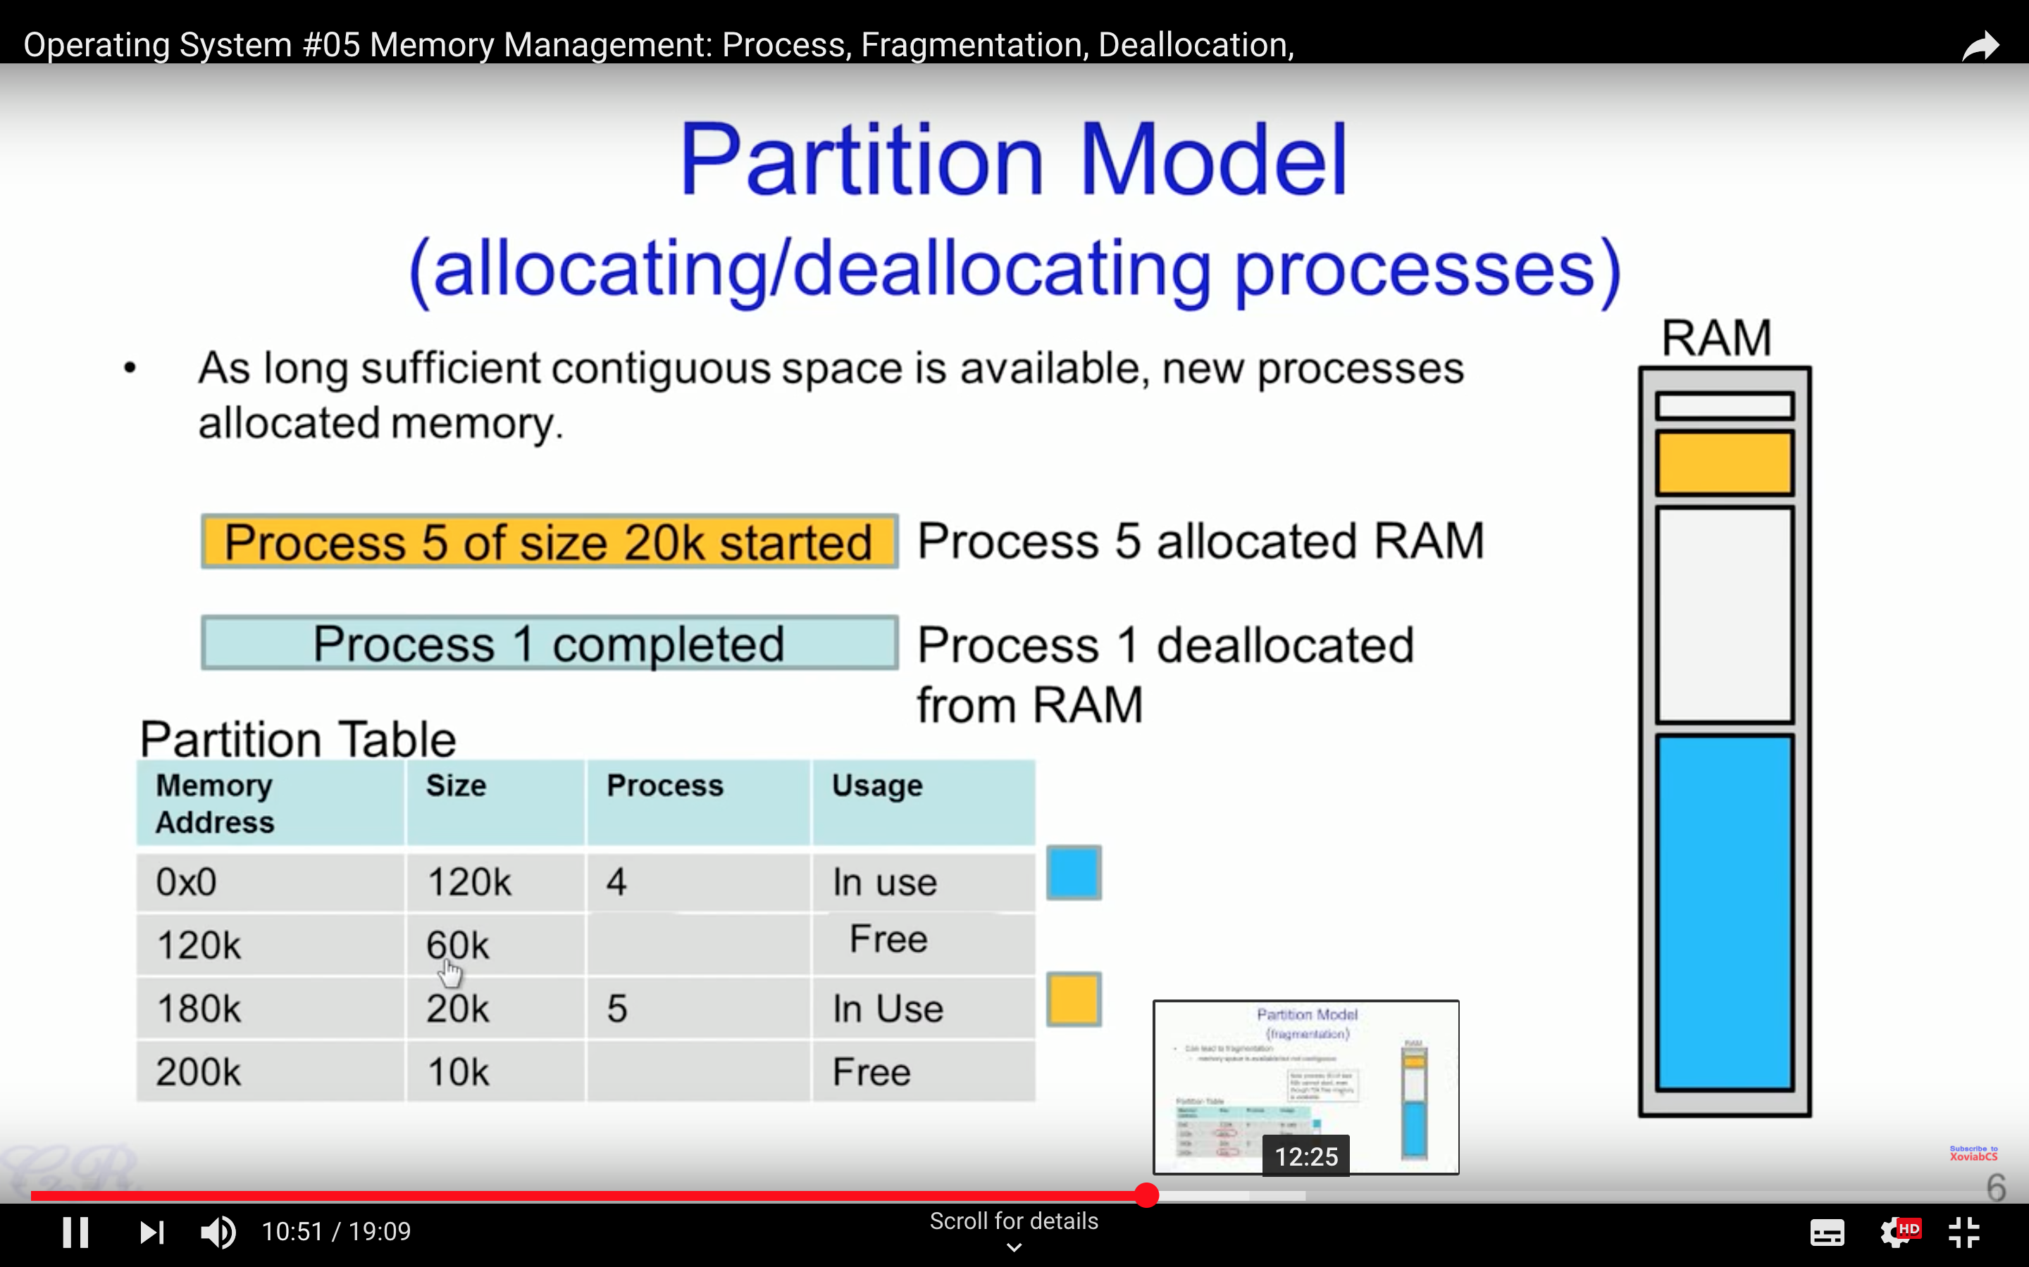

Slide 7
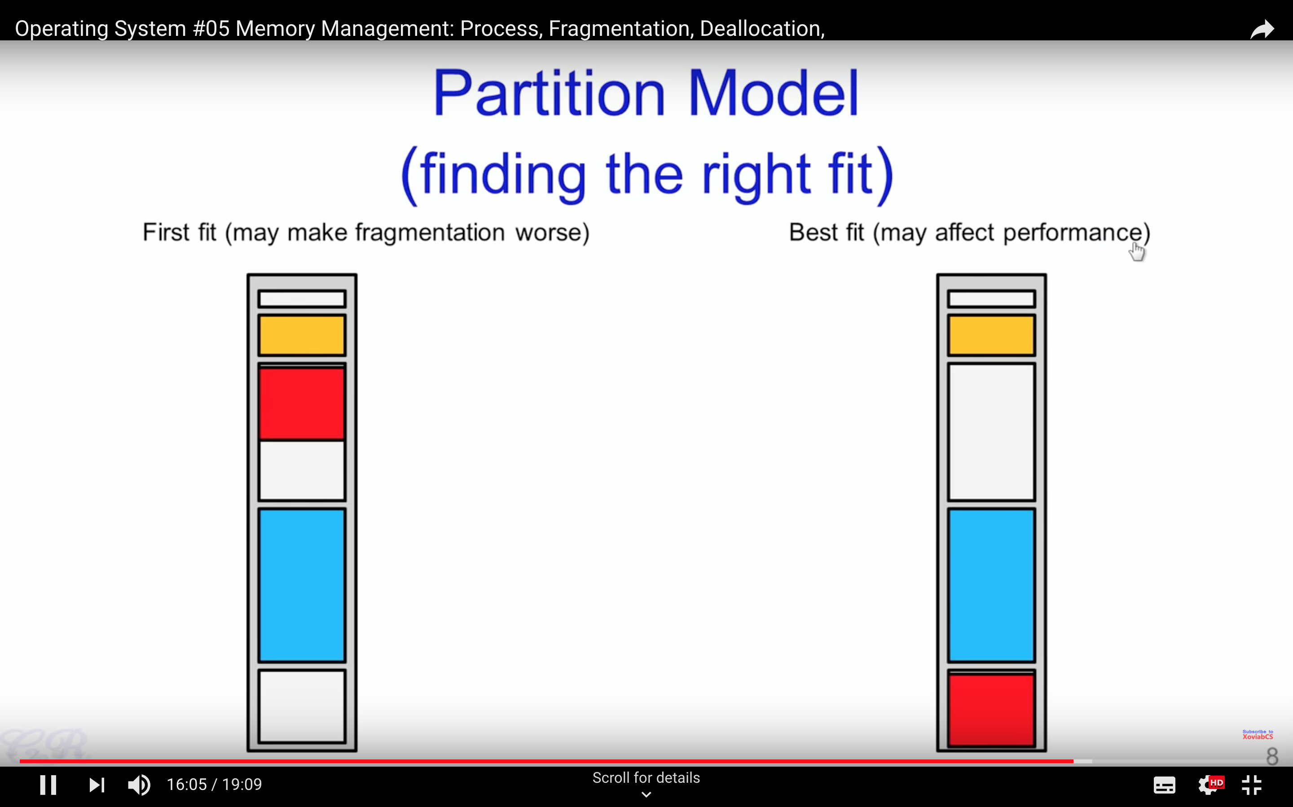

Slide 8
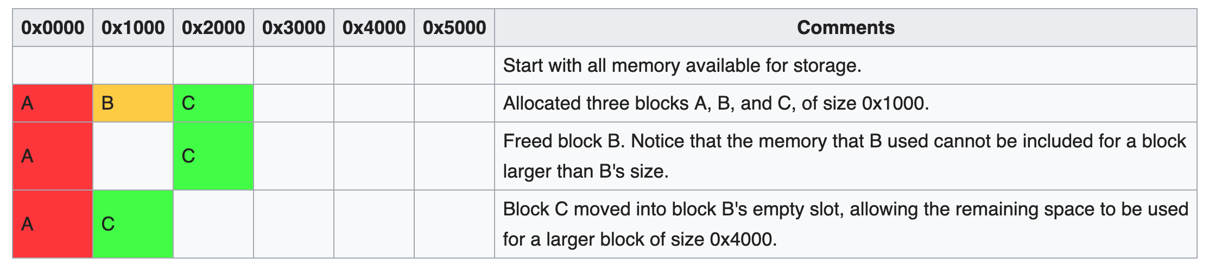
External Fragmentation
External fragmentation arises when free memory is separated into small blocks and is interspersed by allocated memory. It is a weakness of certain storage allocation algorithms, when they fail to order memory used by programs efficiently. The result is that, although free storage is available, it is effectively unusable because it is divided into pieces that are too small individually to satisfy the demands of the application. The term "external" refers to the fact that the unusable storage is outside the allocated regions.
https://en.wikipedia.org/wiki/Fragmentation_(computing)

Slide 9
Segmentation

Slide 10
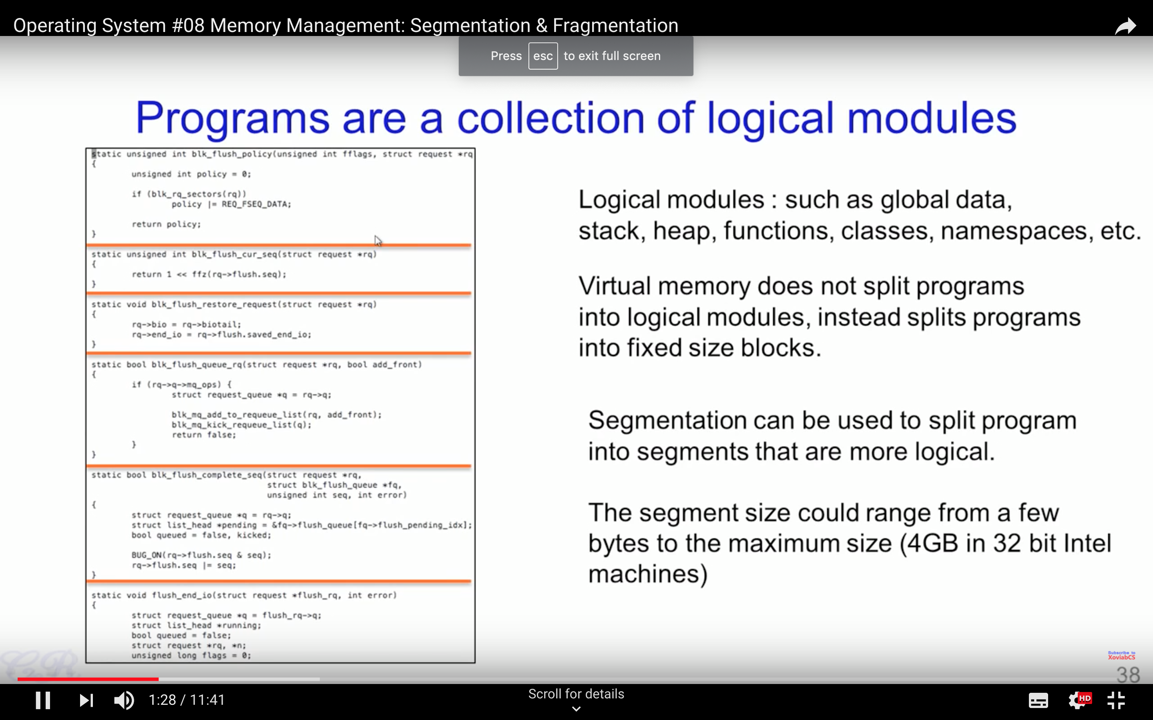

Slide 11
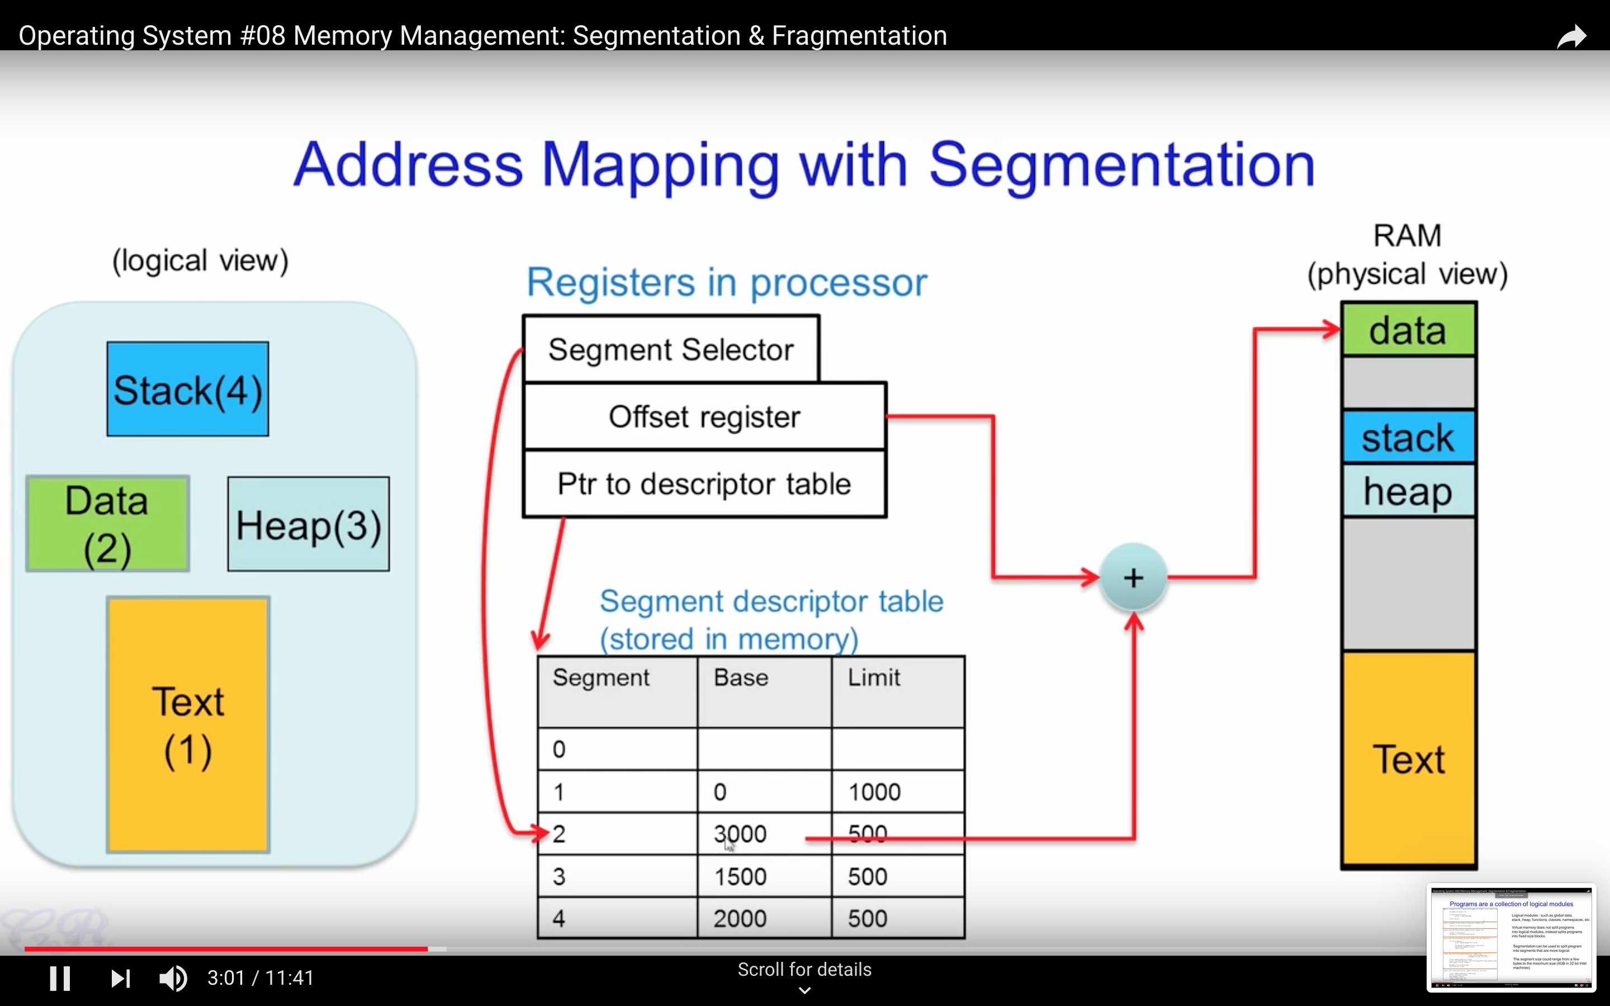

Slide 12
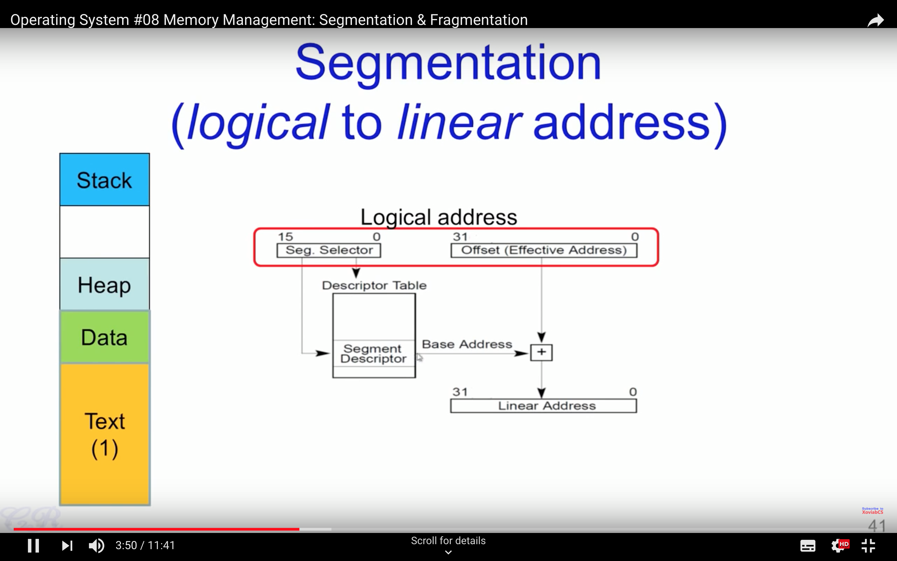

Slide 13
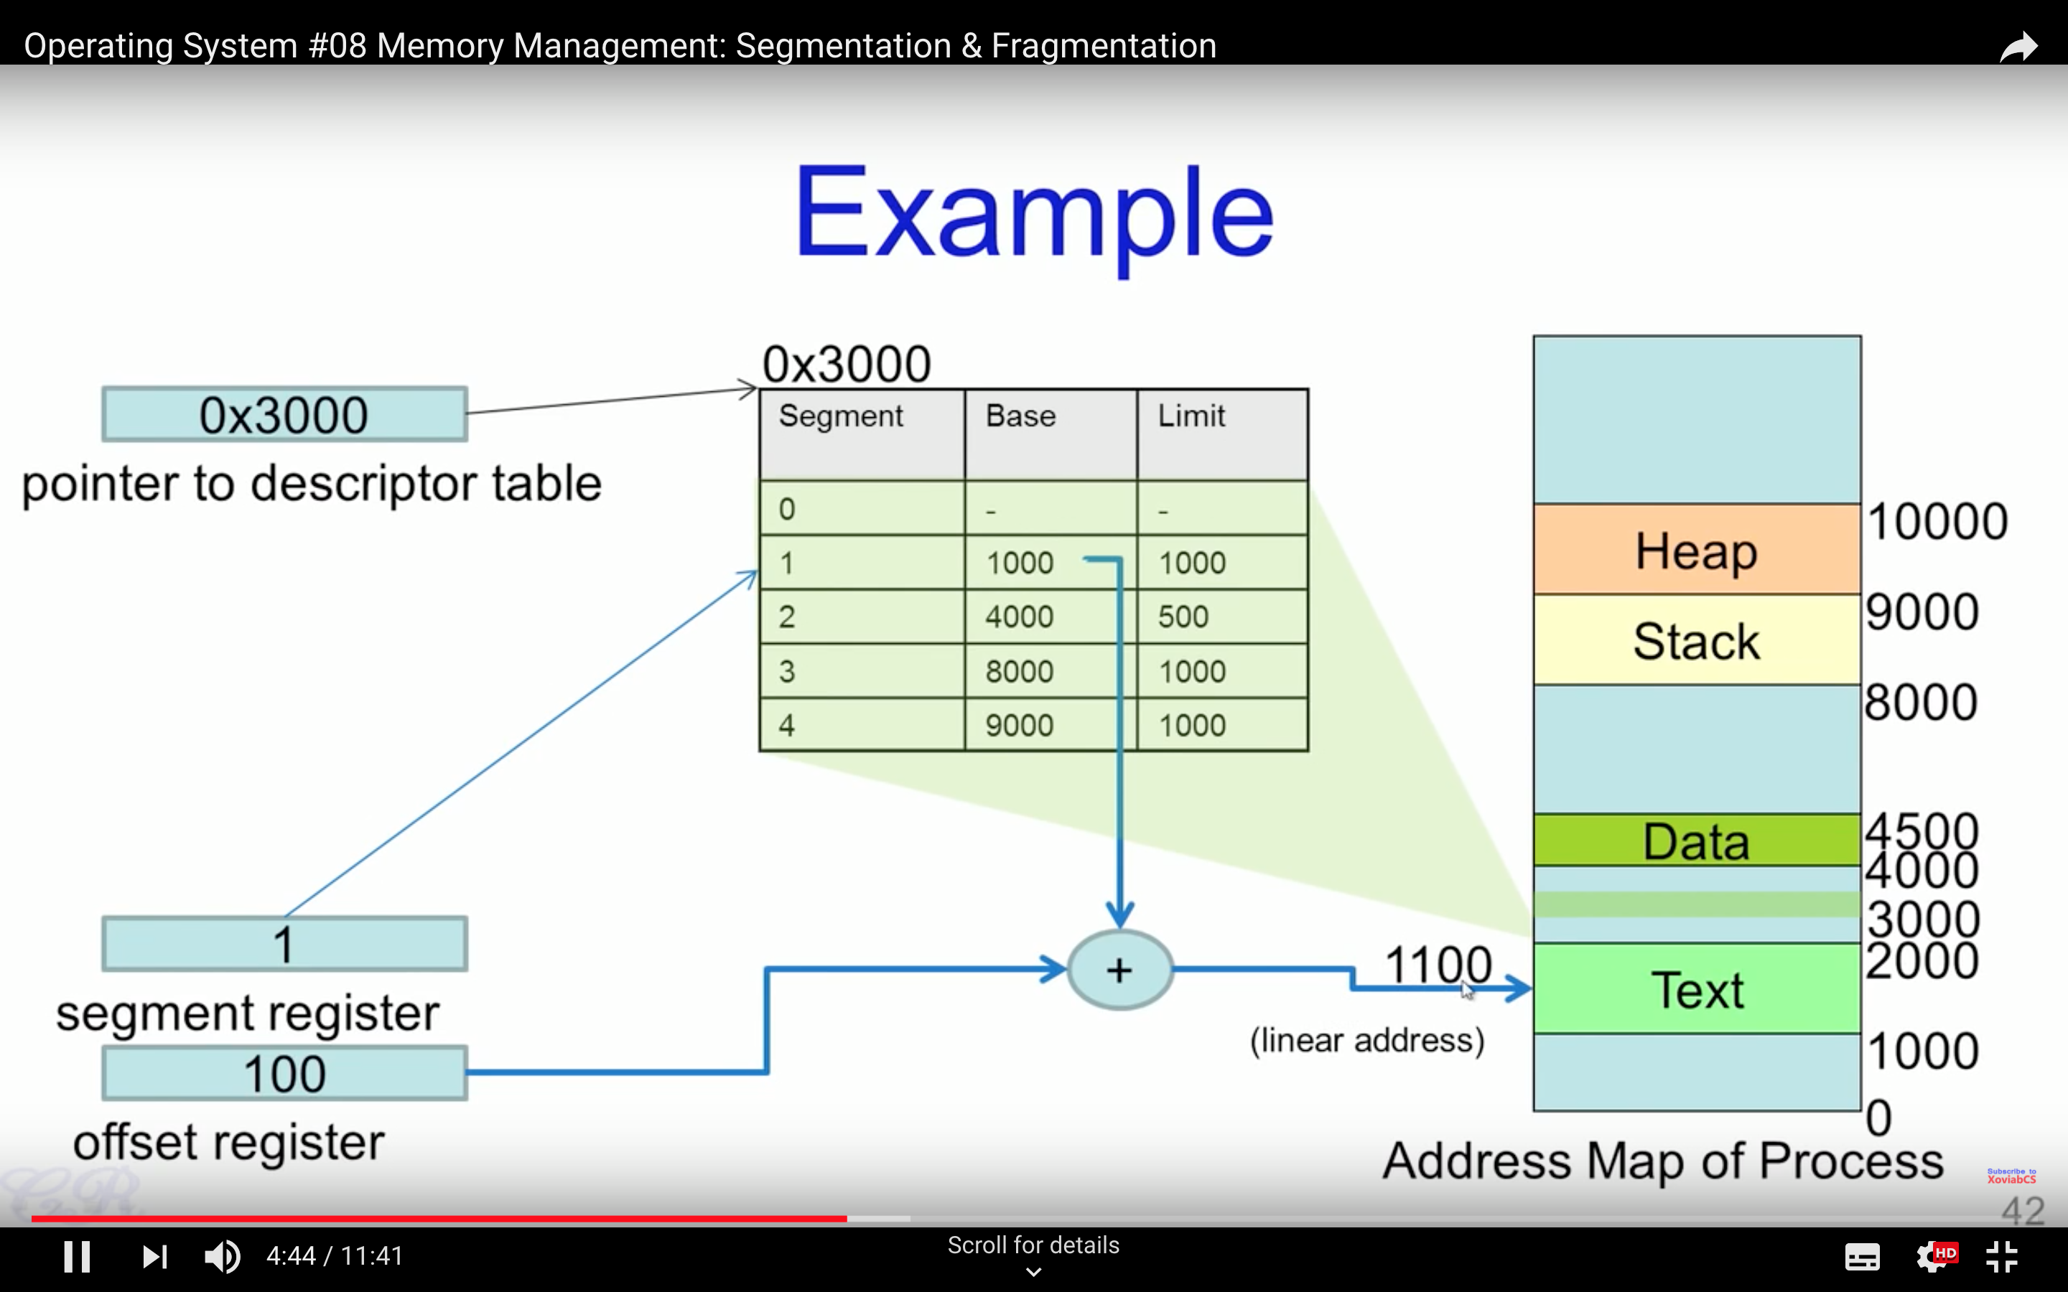

Slide 14
Paging

Slide 15
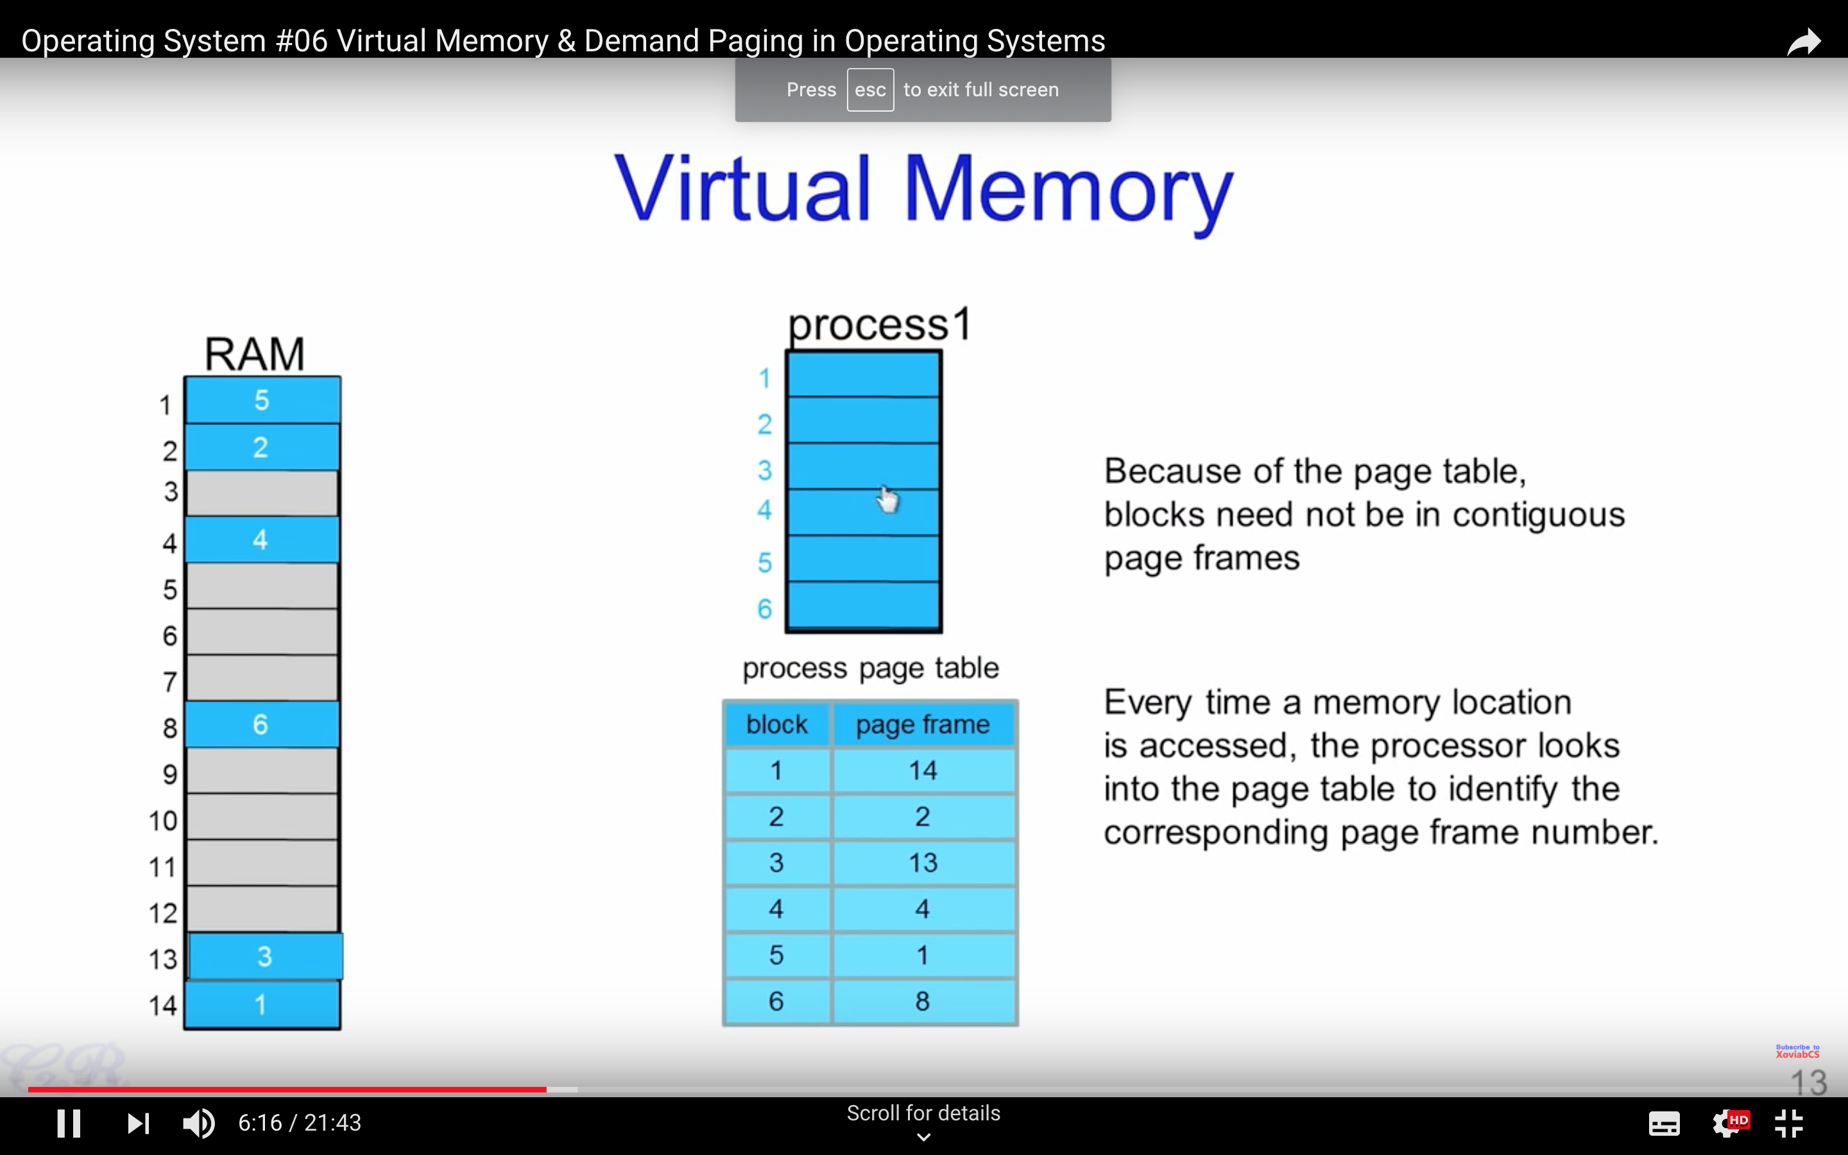

Slide 16
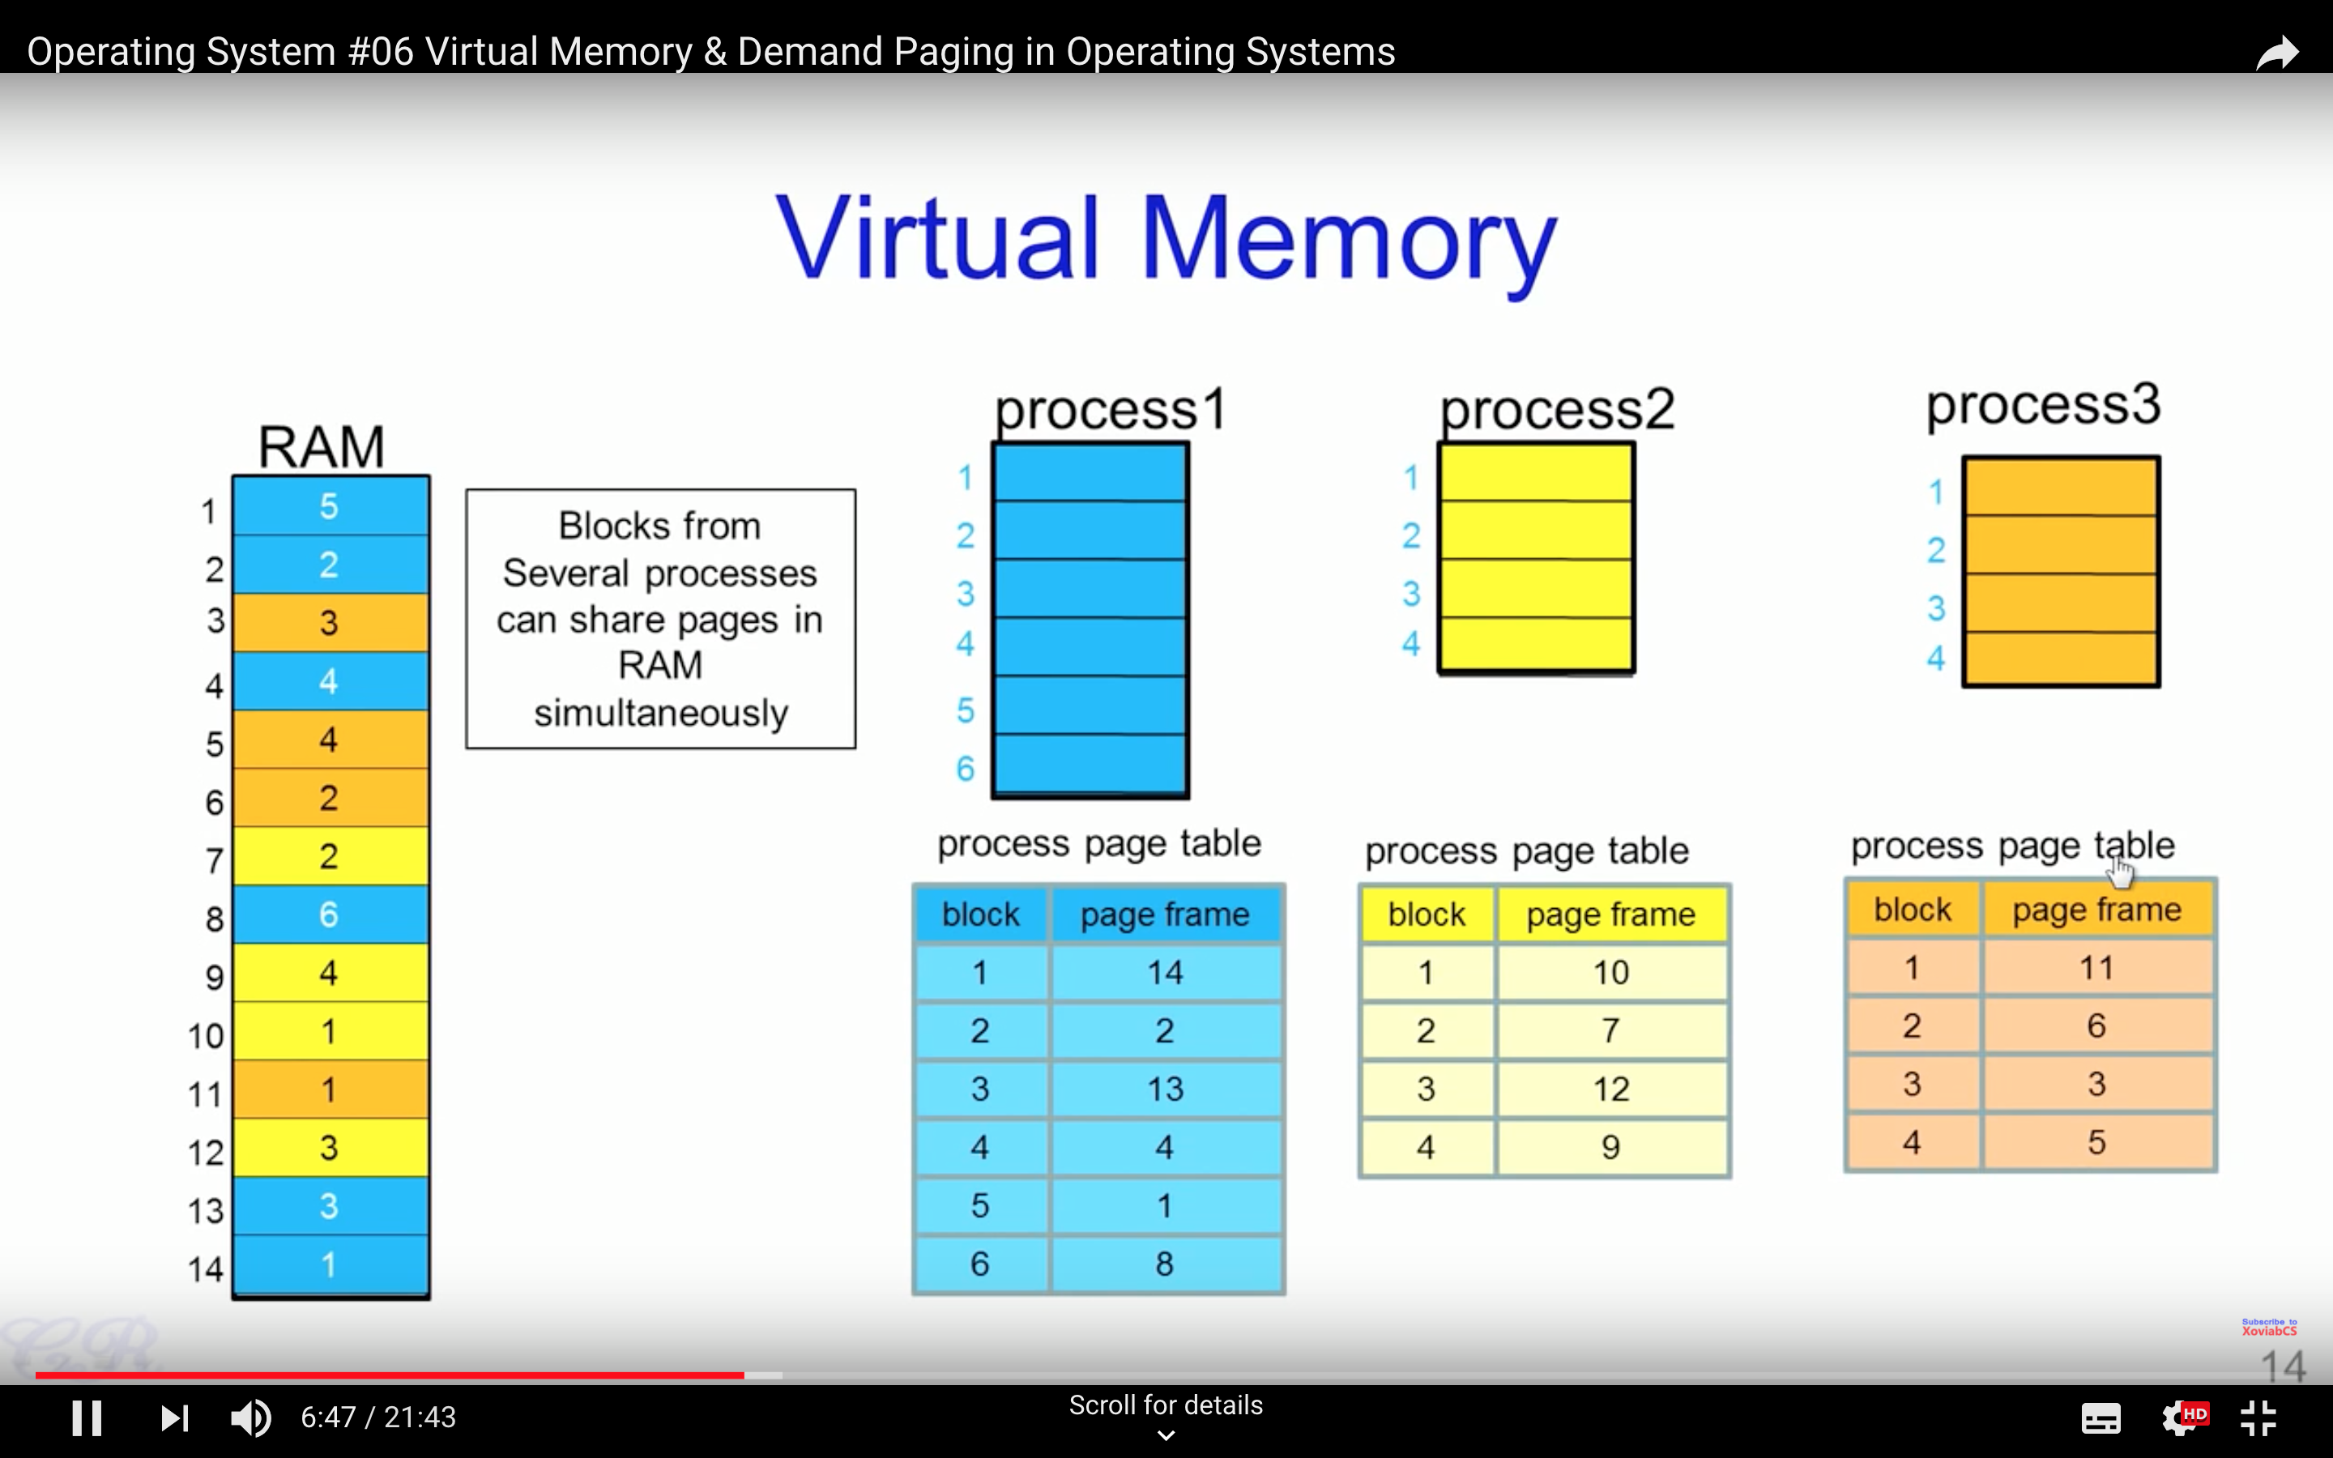

Slide 17
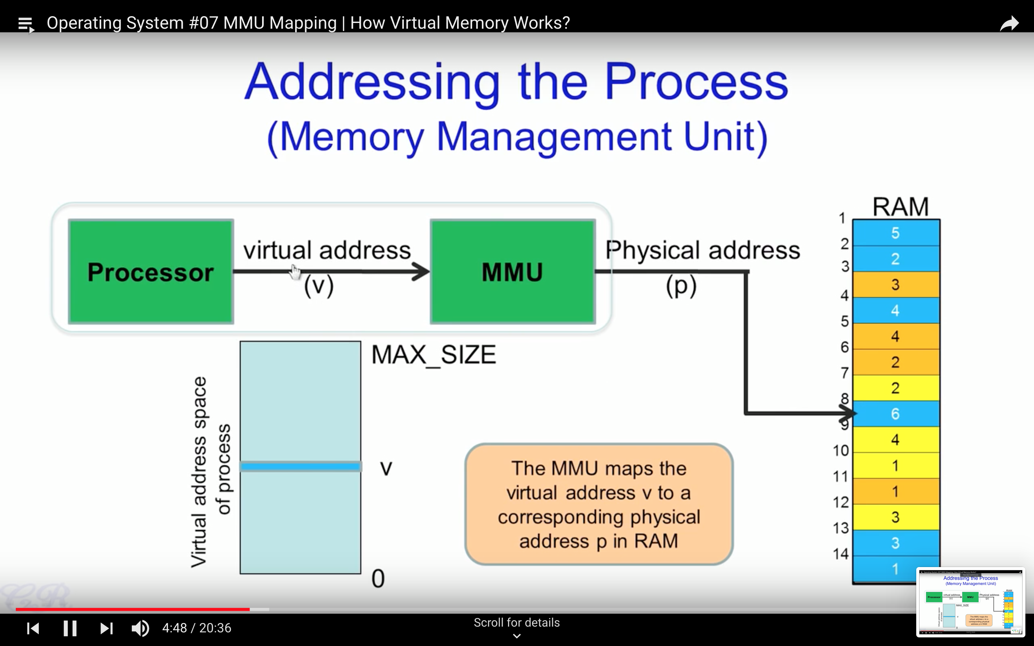

Slide 18
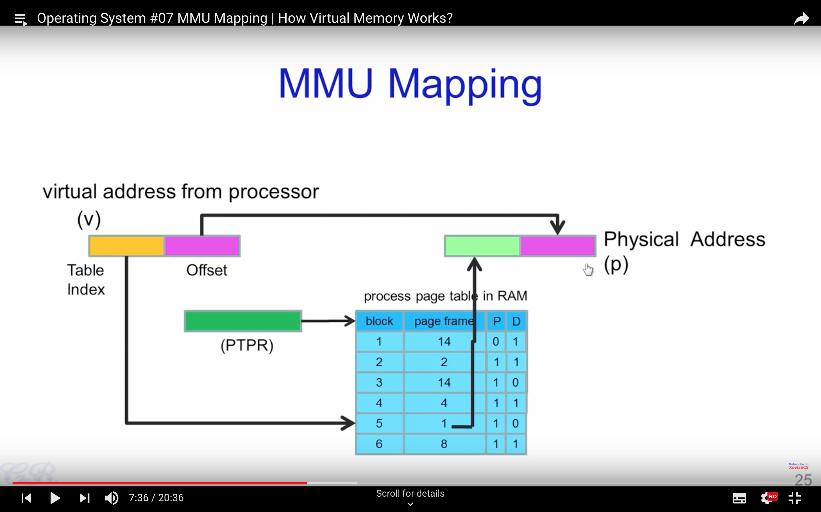

Slide 19
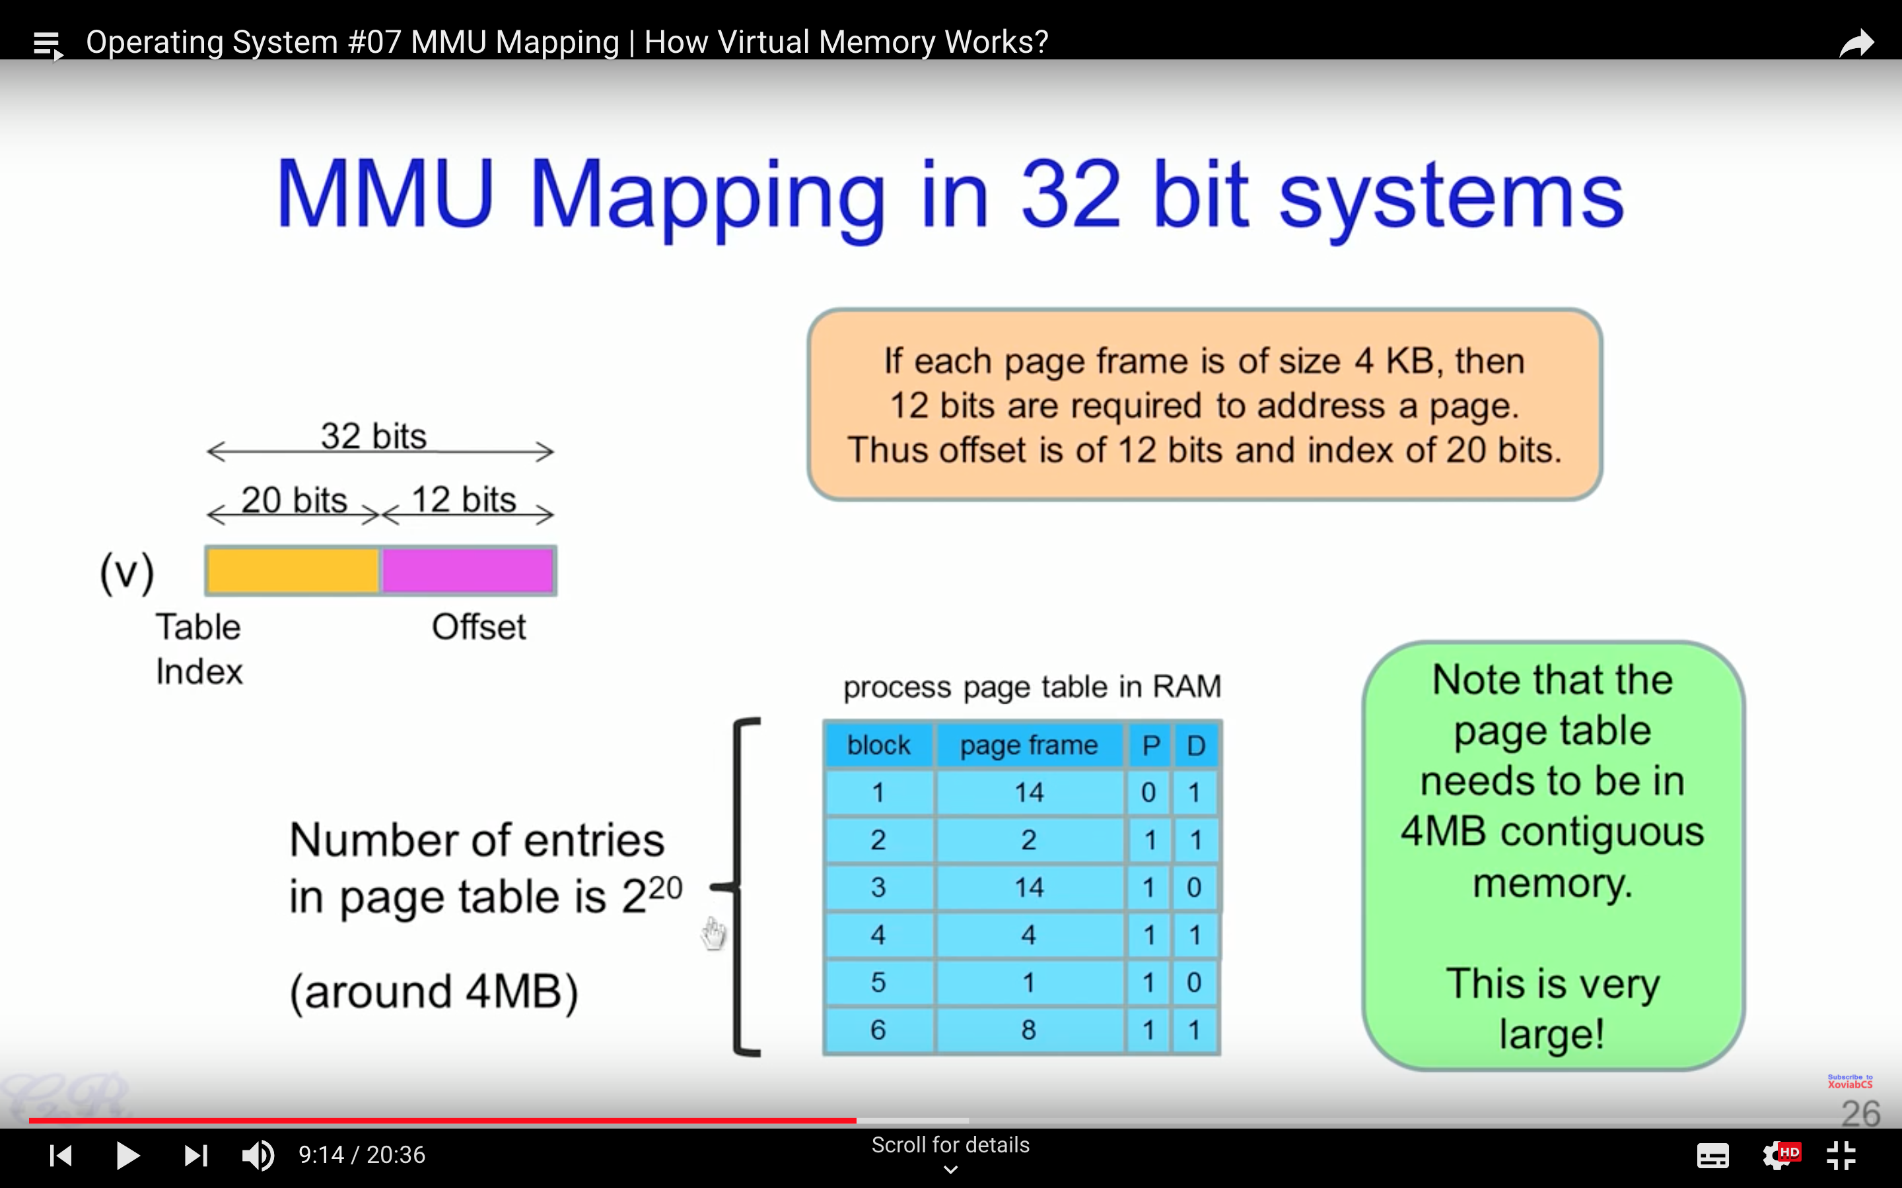

Slide 20
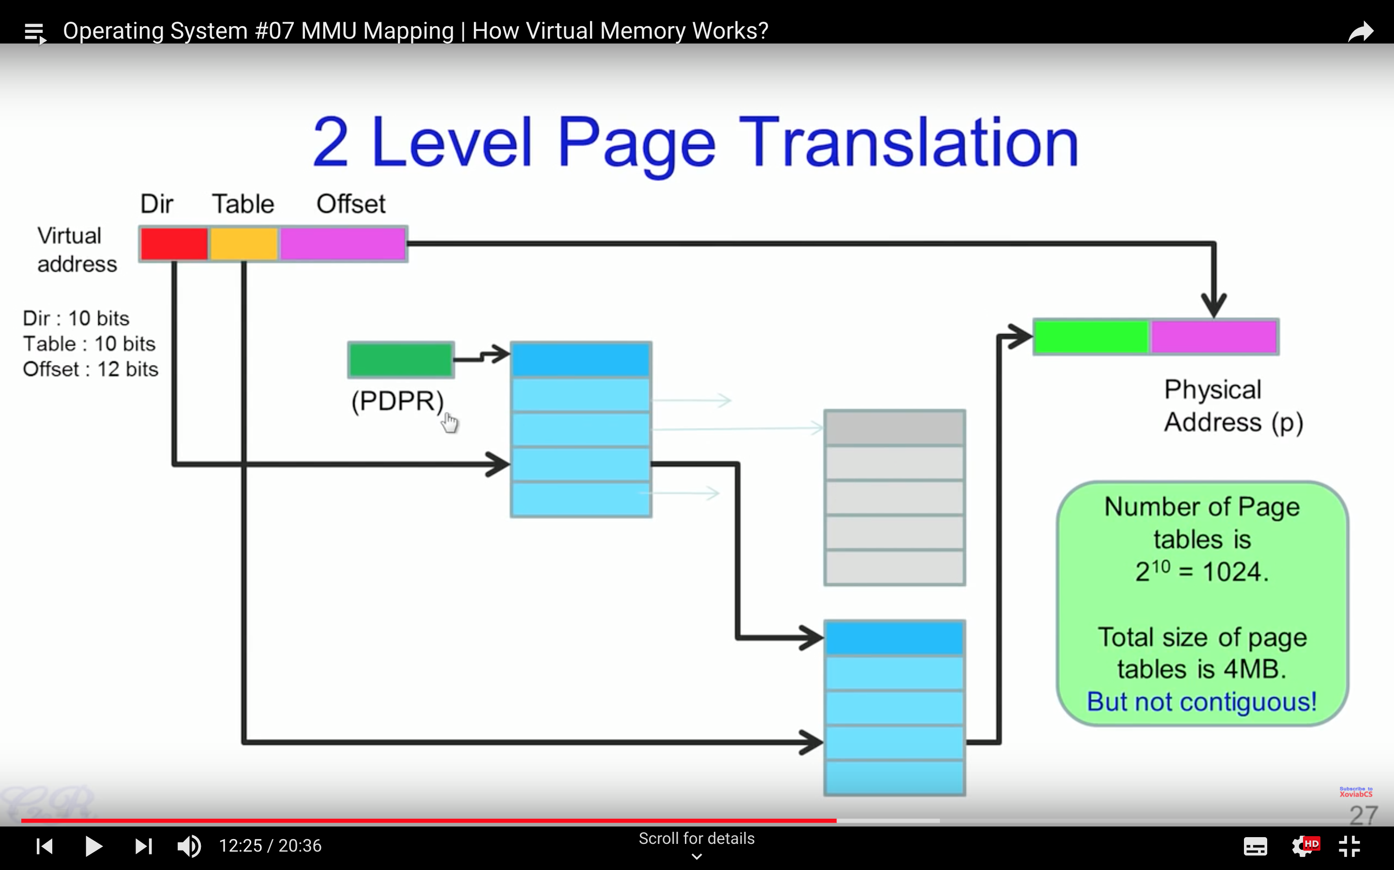

Slide 21
Internal Fragmentation
Due to the rules governing memory allocation, more computer memory is sometimes allocated than is needed. For example, memory can only be provided to programs in chunks( multiple of 4) , and as a result if a program requests perhaps 29 bytes, it will actually get a chunk of 32 bytes. When this happens, the excess memory goes to waste. In this scenario, the unusable memory is contained within an allocated region. This arrangement, termed fixed partitions, suffers from inefficient memory use - any process, no matter how small, occupies an entire partition. This waste is called internal fragmentation.
https://en.wikipedia.org/wiki/Fragmentation_(computing)

Slide 22
Virtual Memory

Slide 23
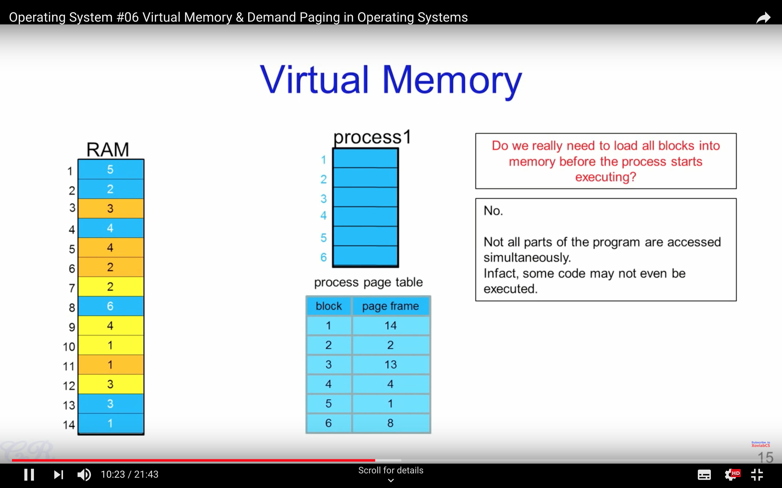

Slide 25
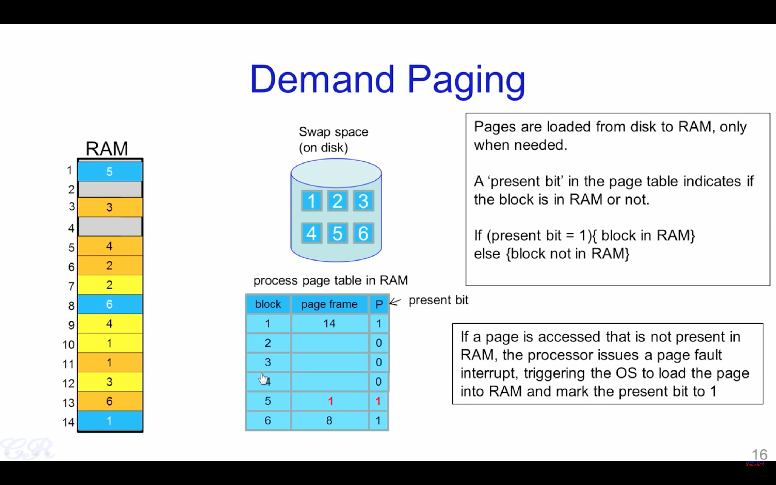

Slide 26
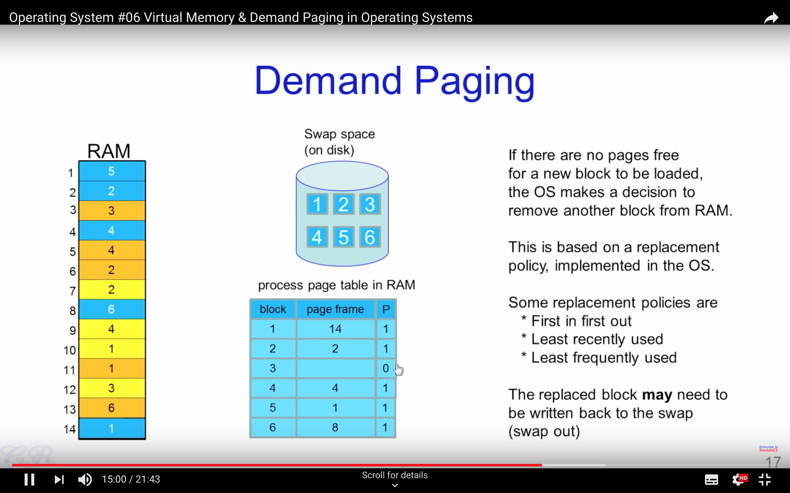

Slide 27
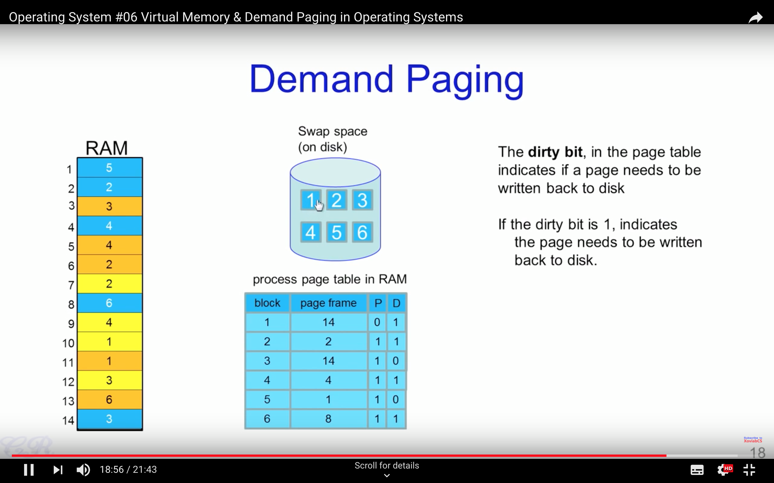

Slide 28
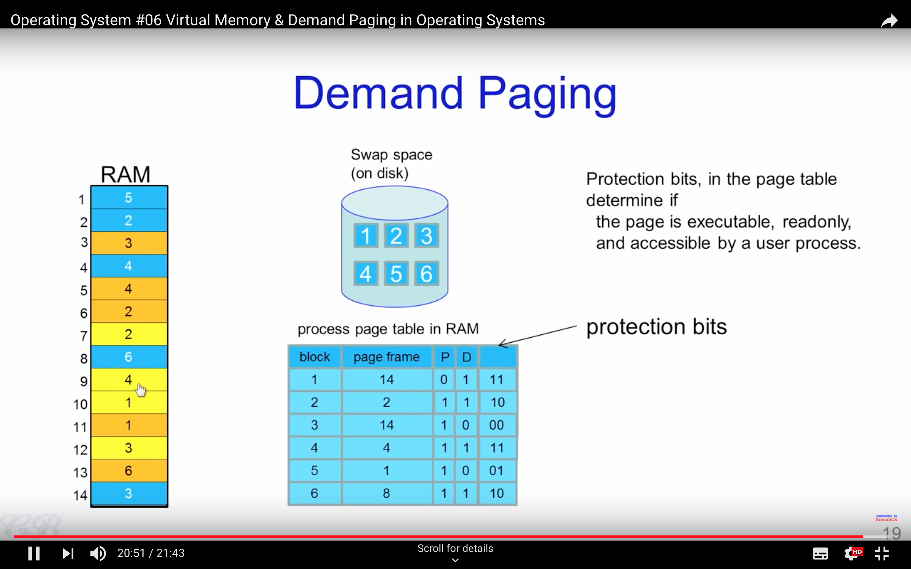

Slide 29
Step by Step Behaviour

Slide 30
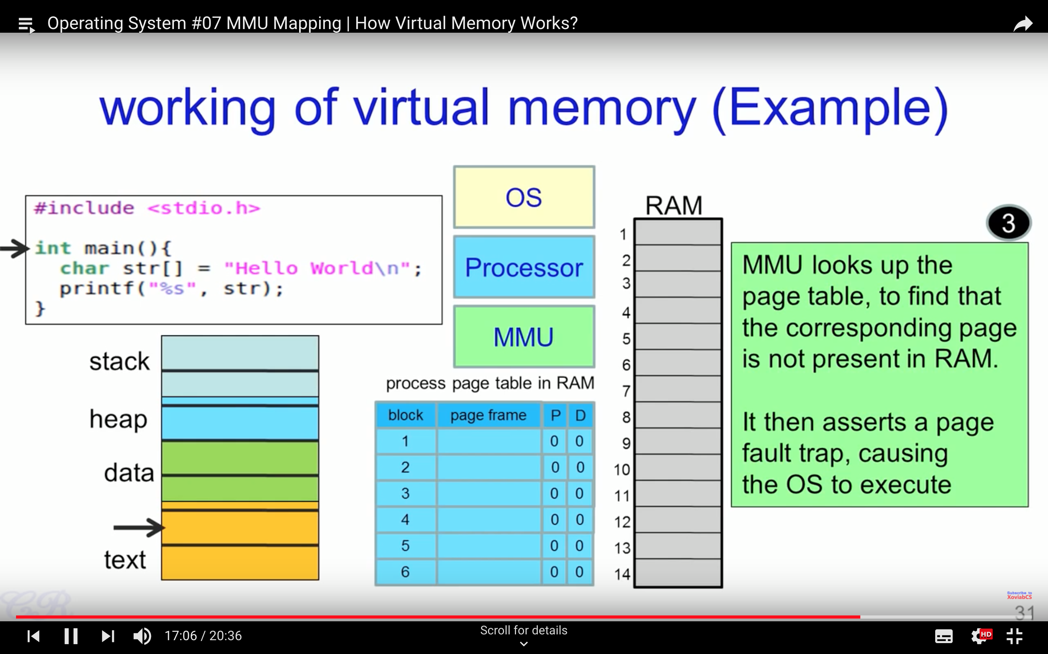

Slide 31
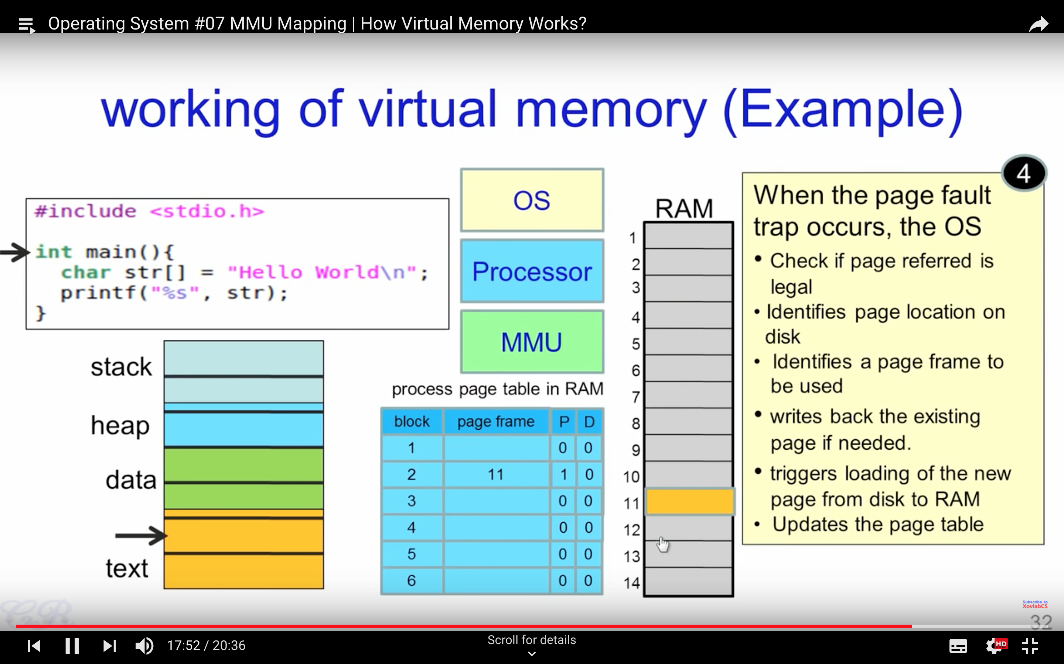

Slide 32
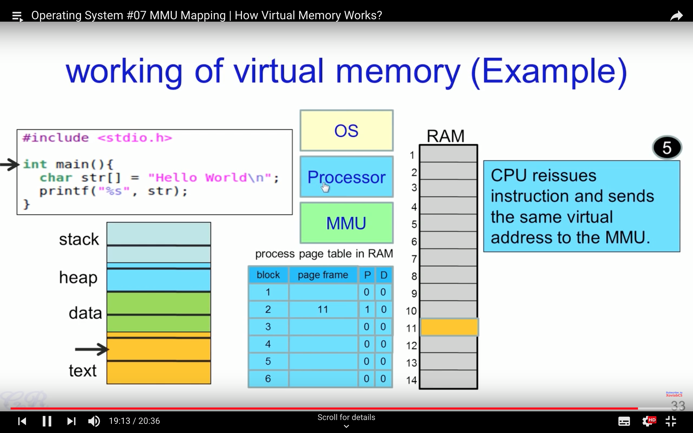

Slide 33
MM in XV6

Slide 34
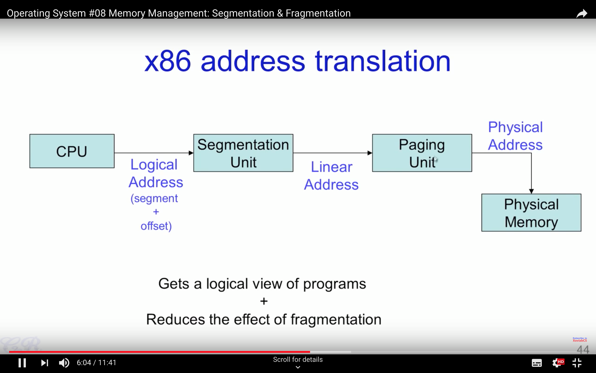

Slide 35
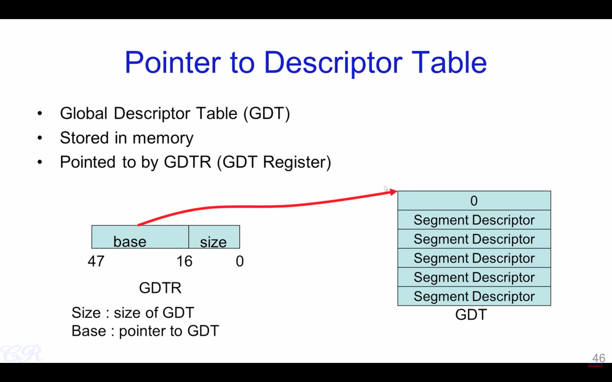

Slide 36
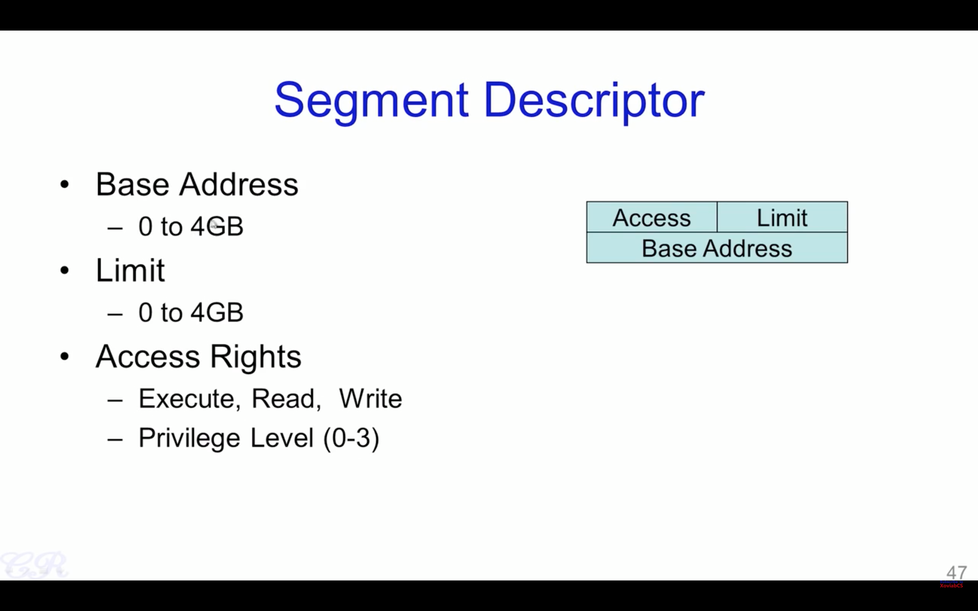

Slide 38
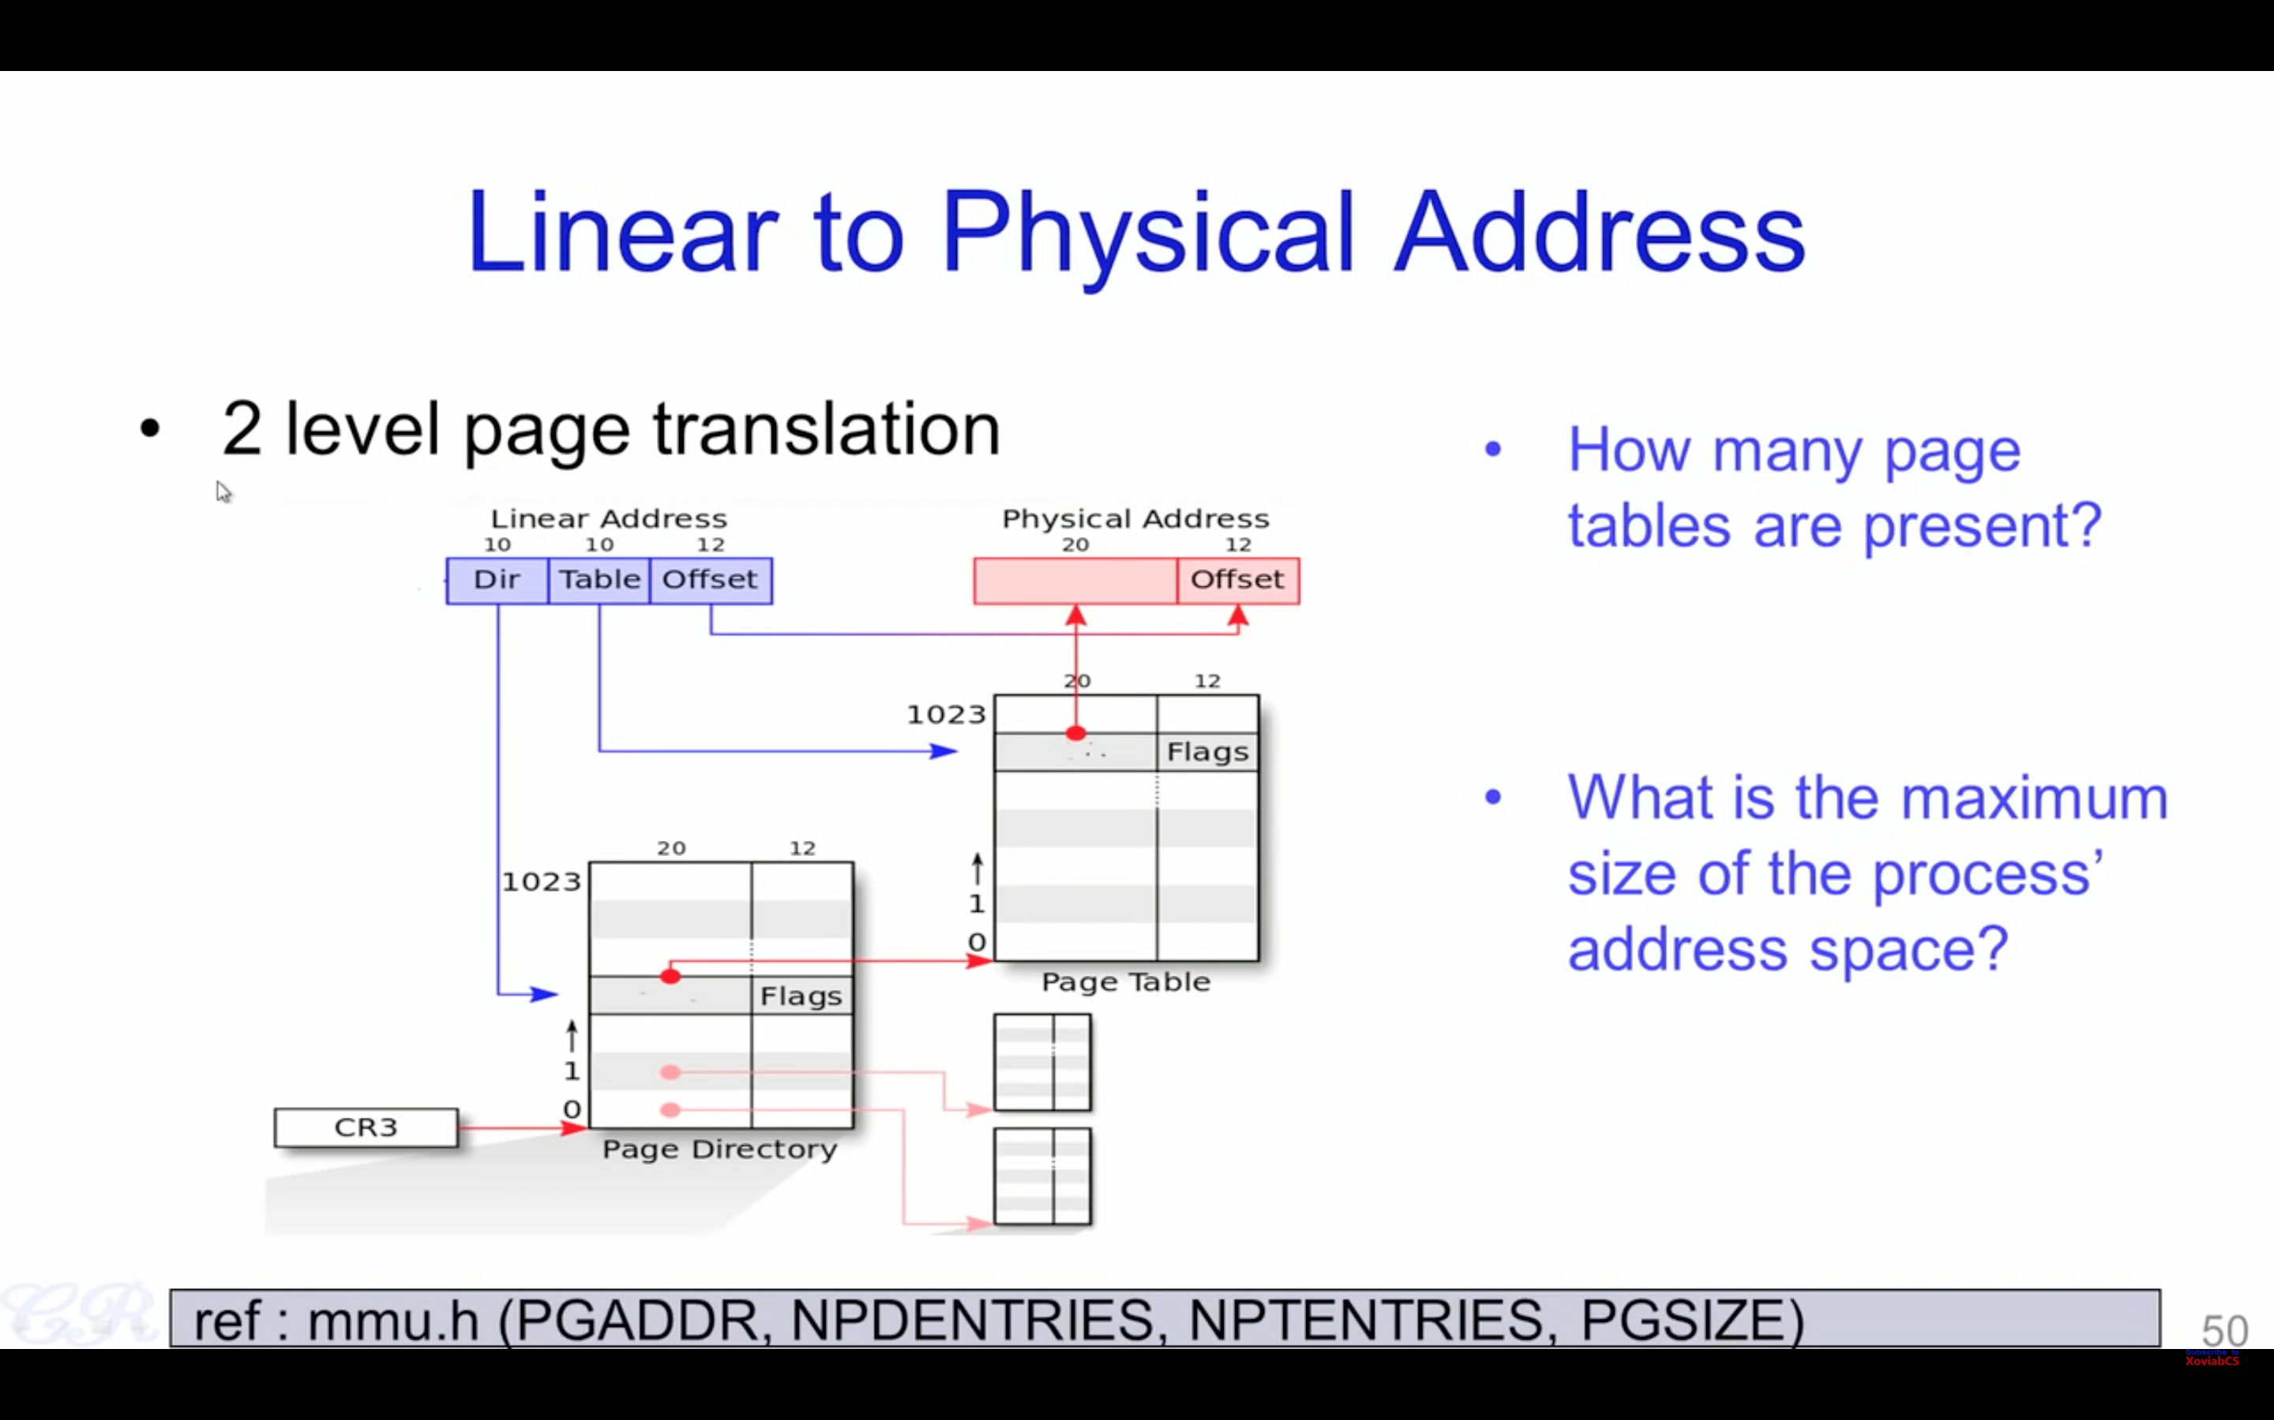

Slide 39
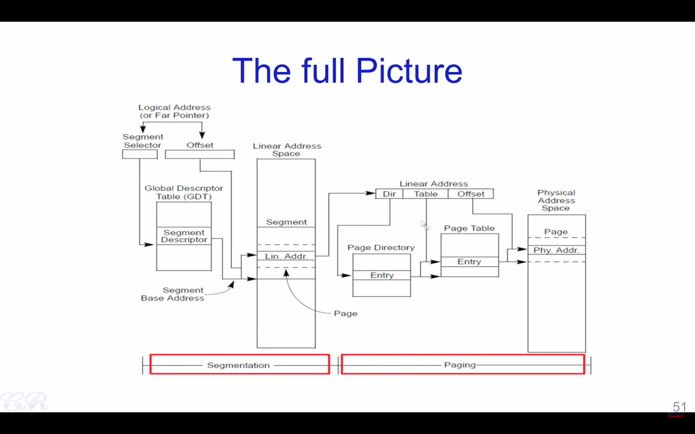

Slide 40
MM in XV6
More in detail

Slide 41
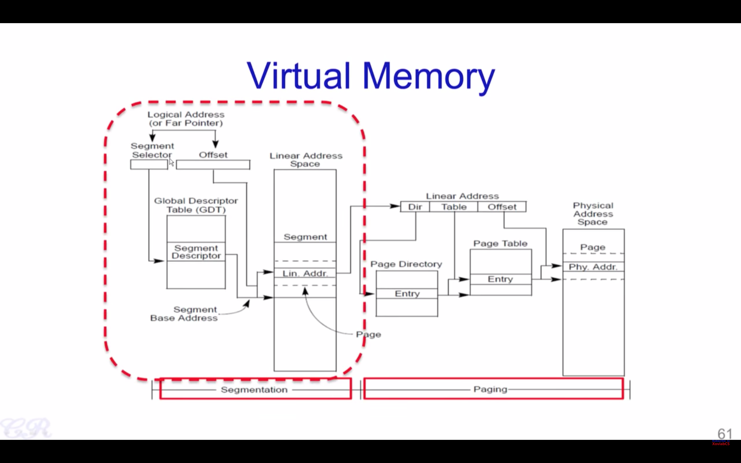

Slide 44
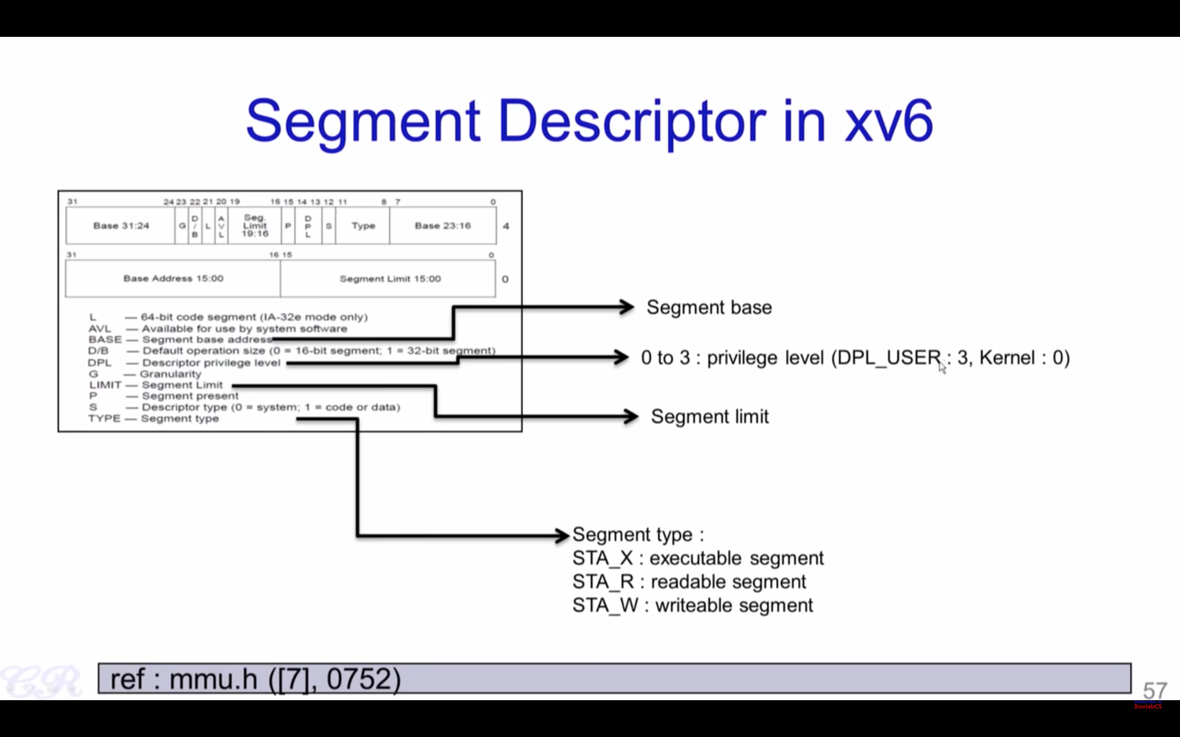

Slide 45
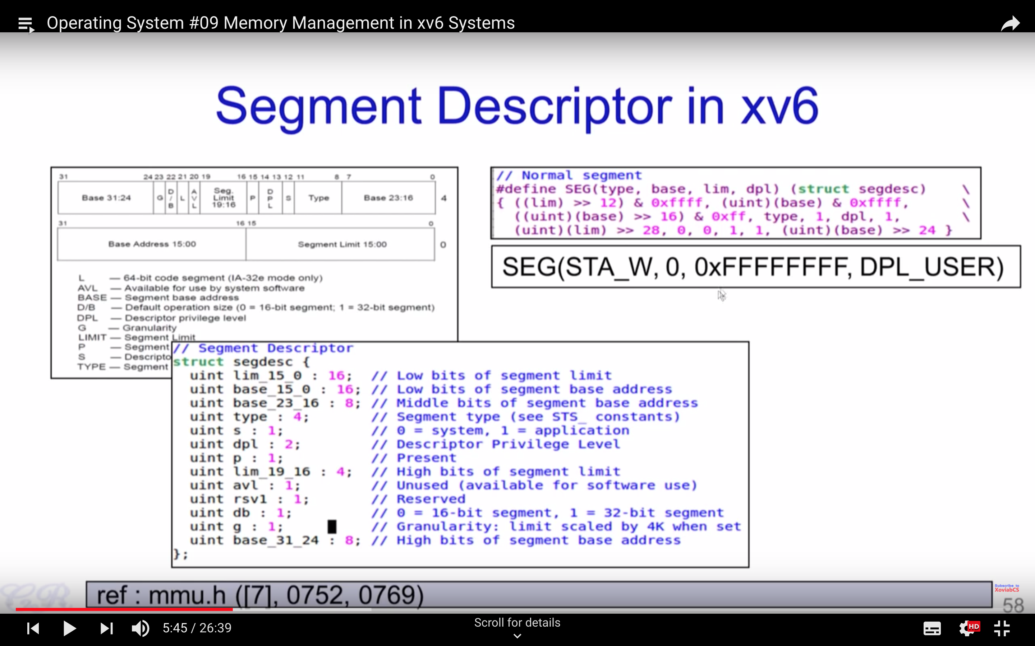

Slide 46
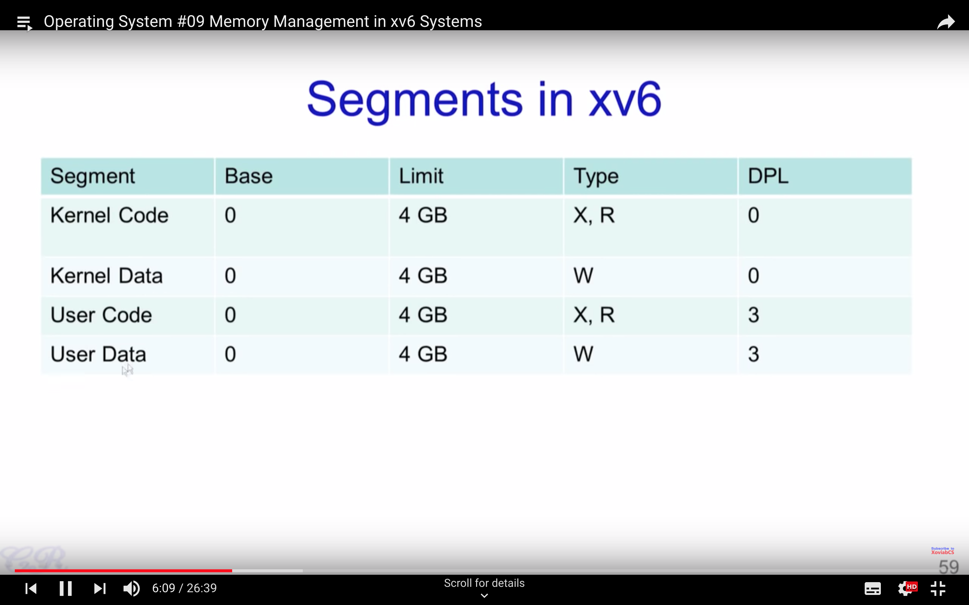

Slide 47
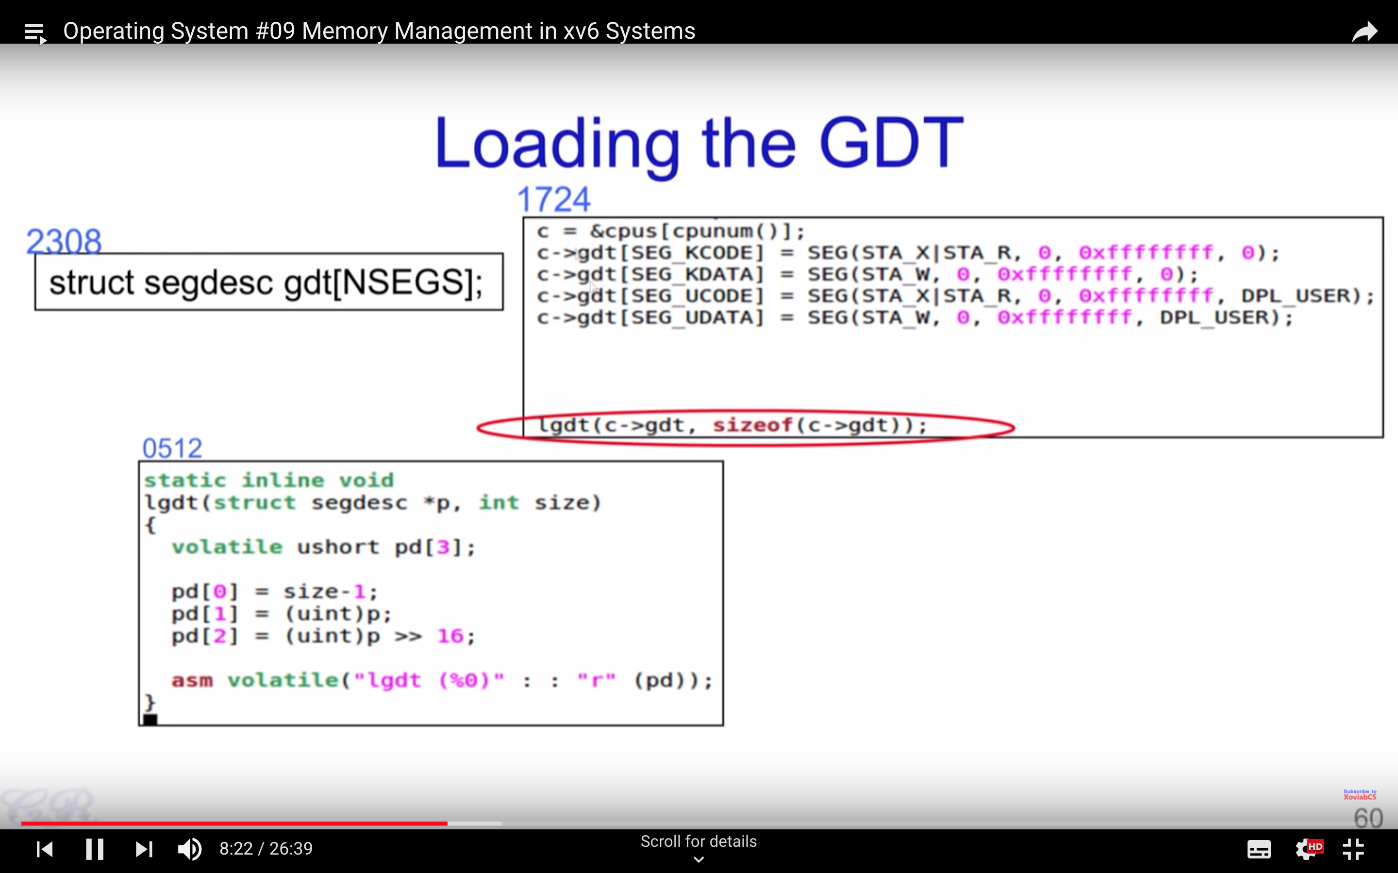

Slide 48
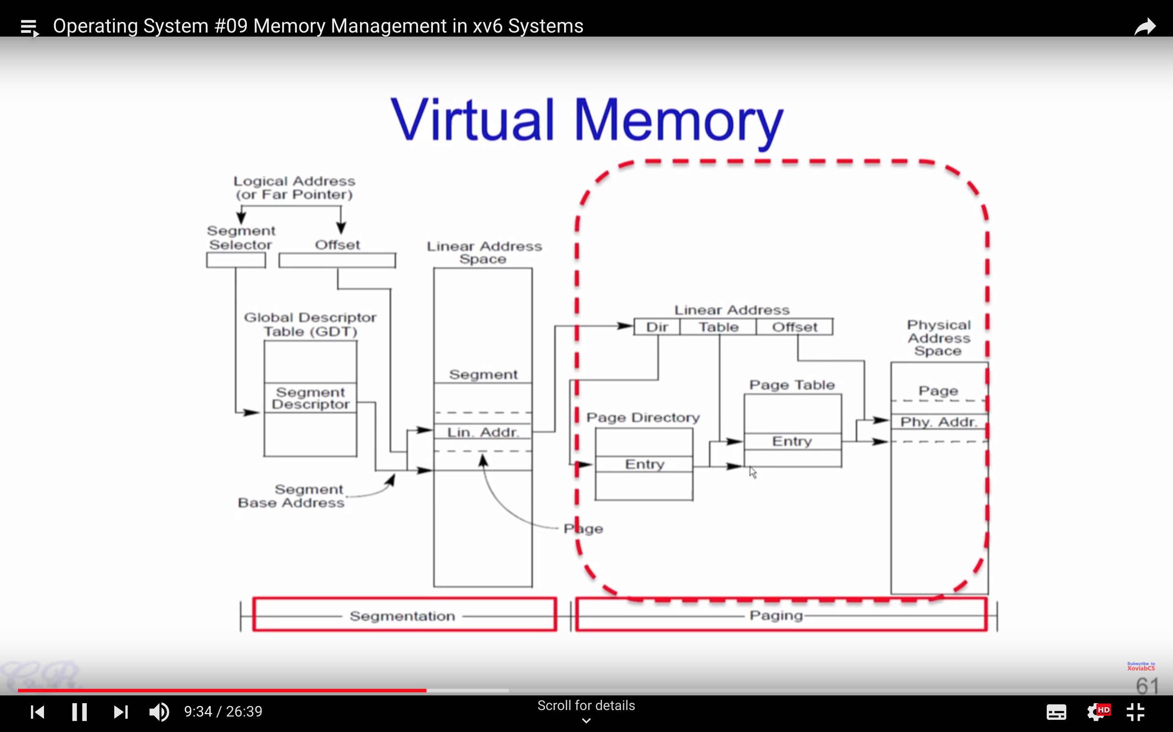

Slide 49
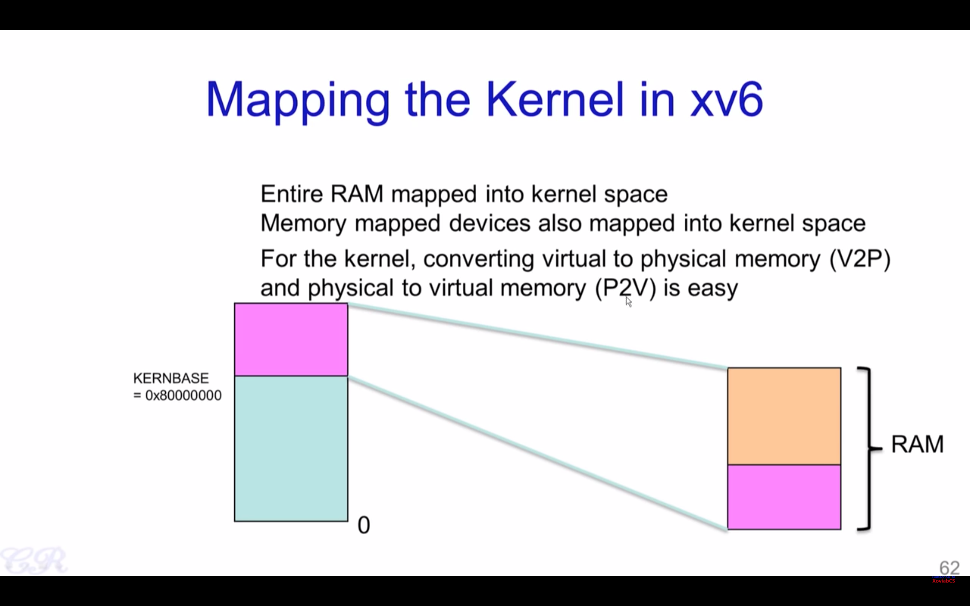

Slide 50
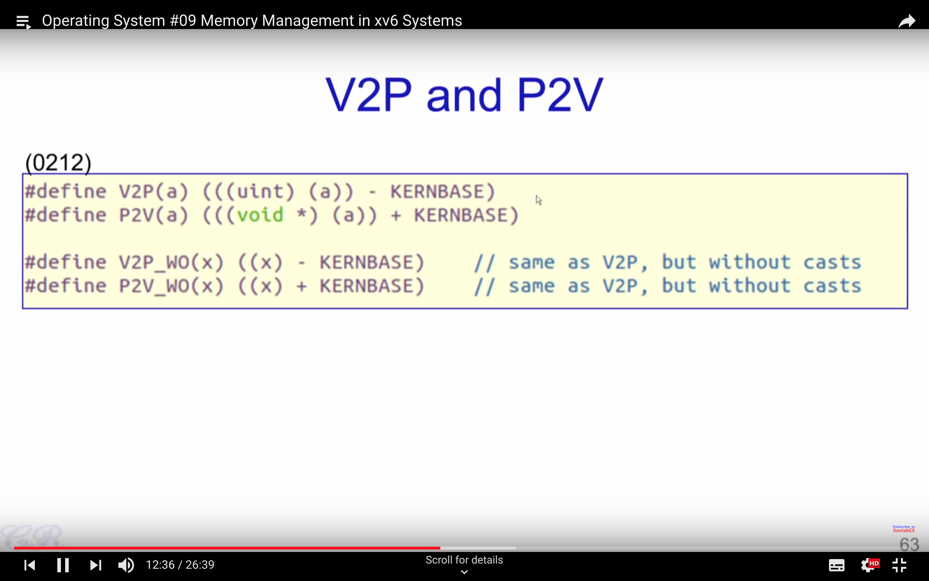

Slide 51
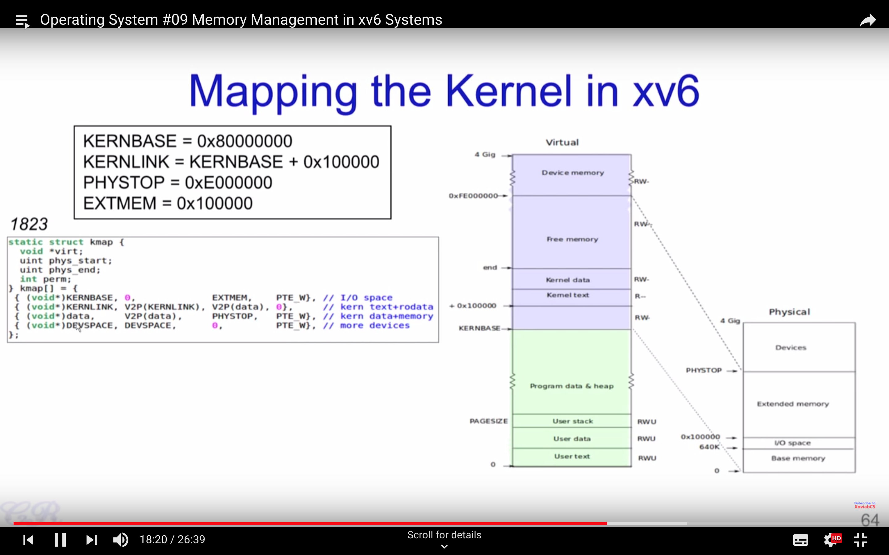

Slide 52
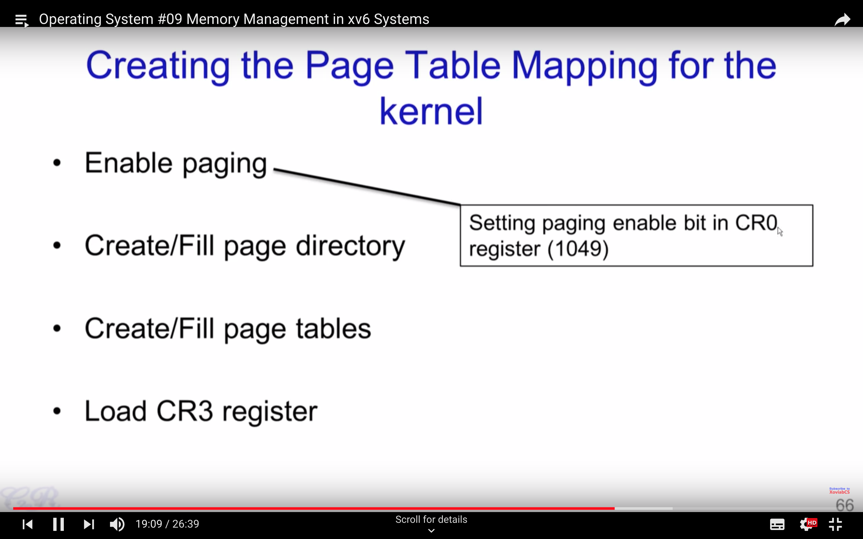

Slide 53
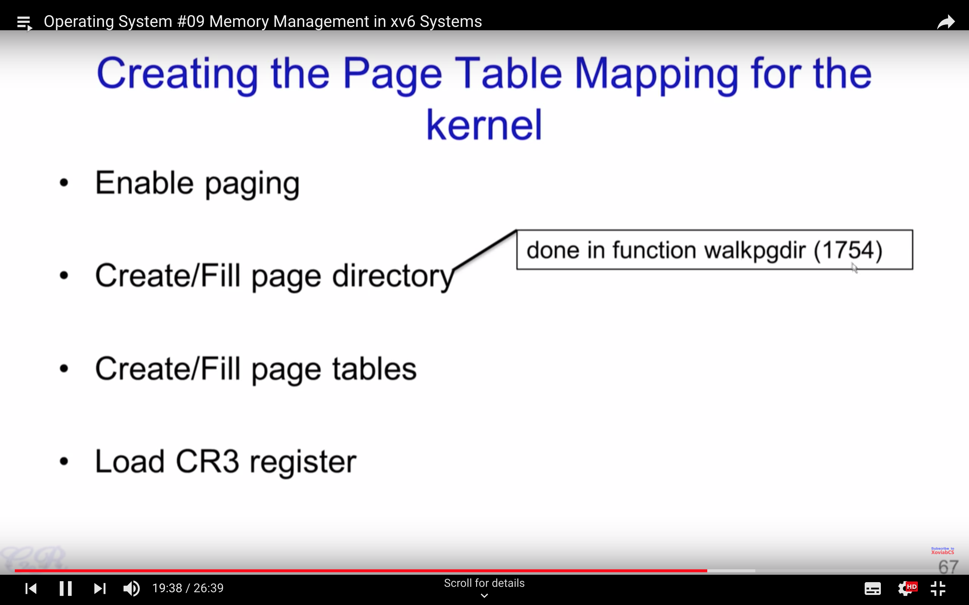

Slide 54
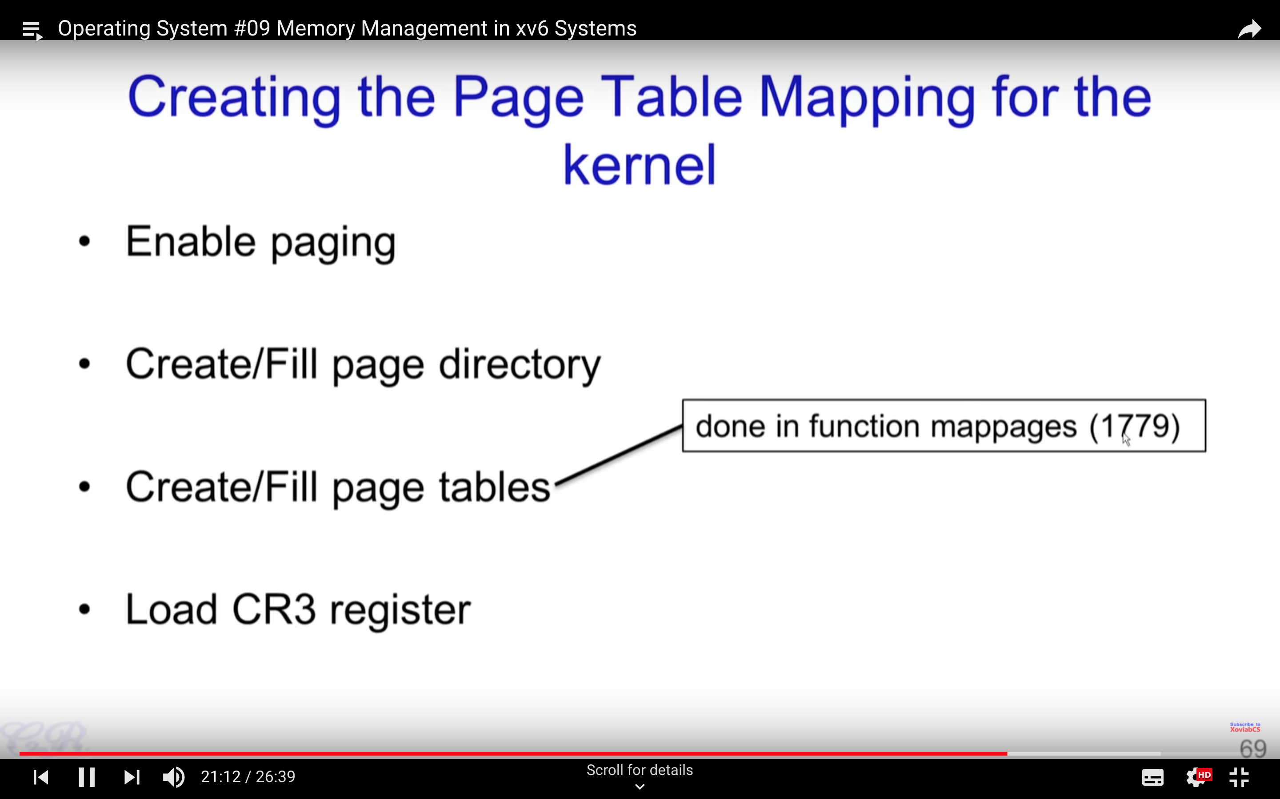

Slide 55
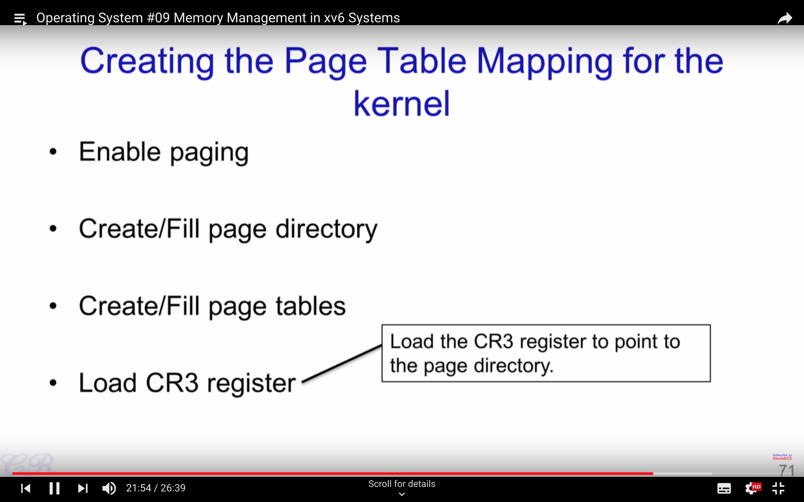

Slide 56
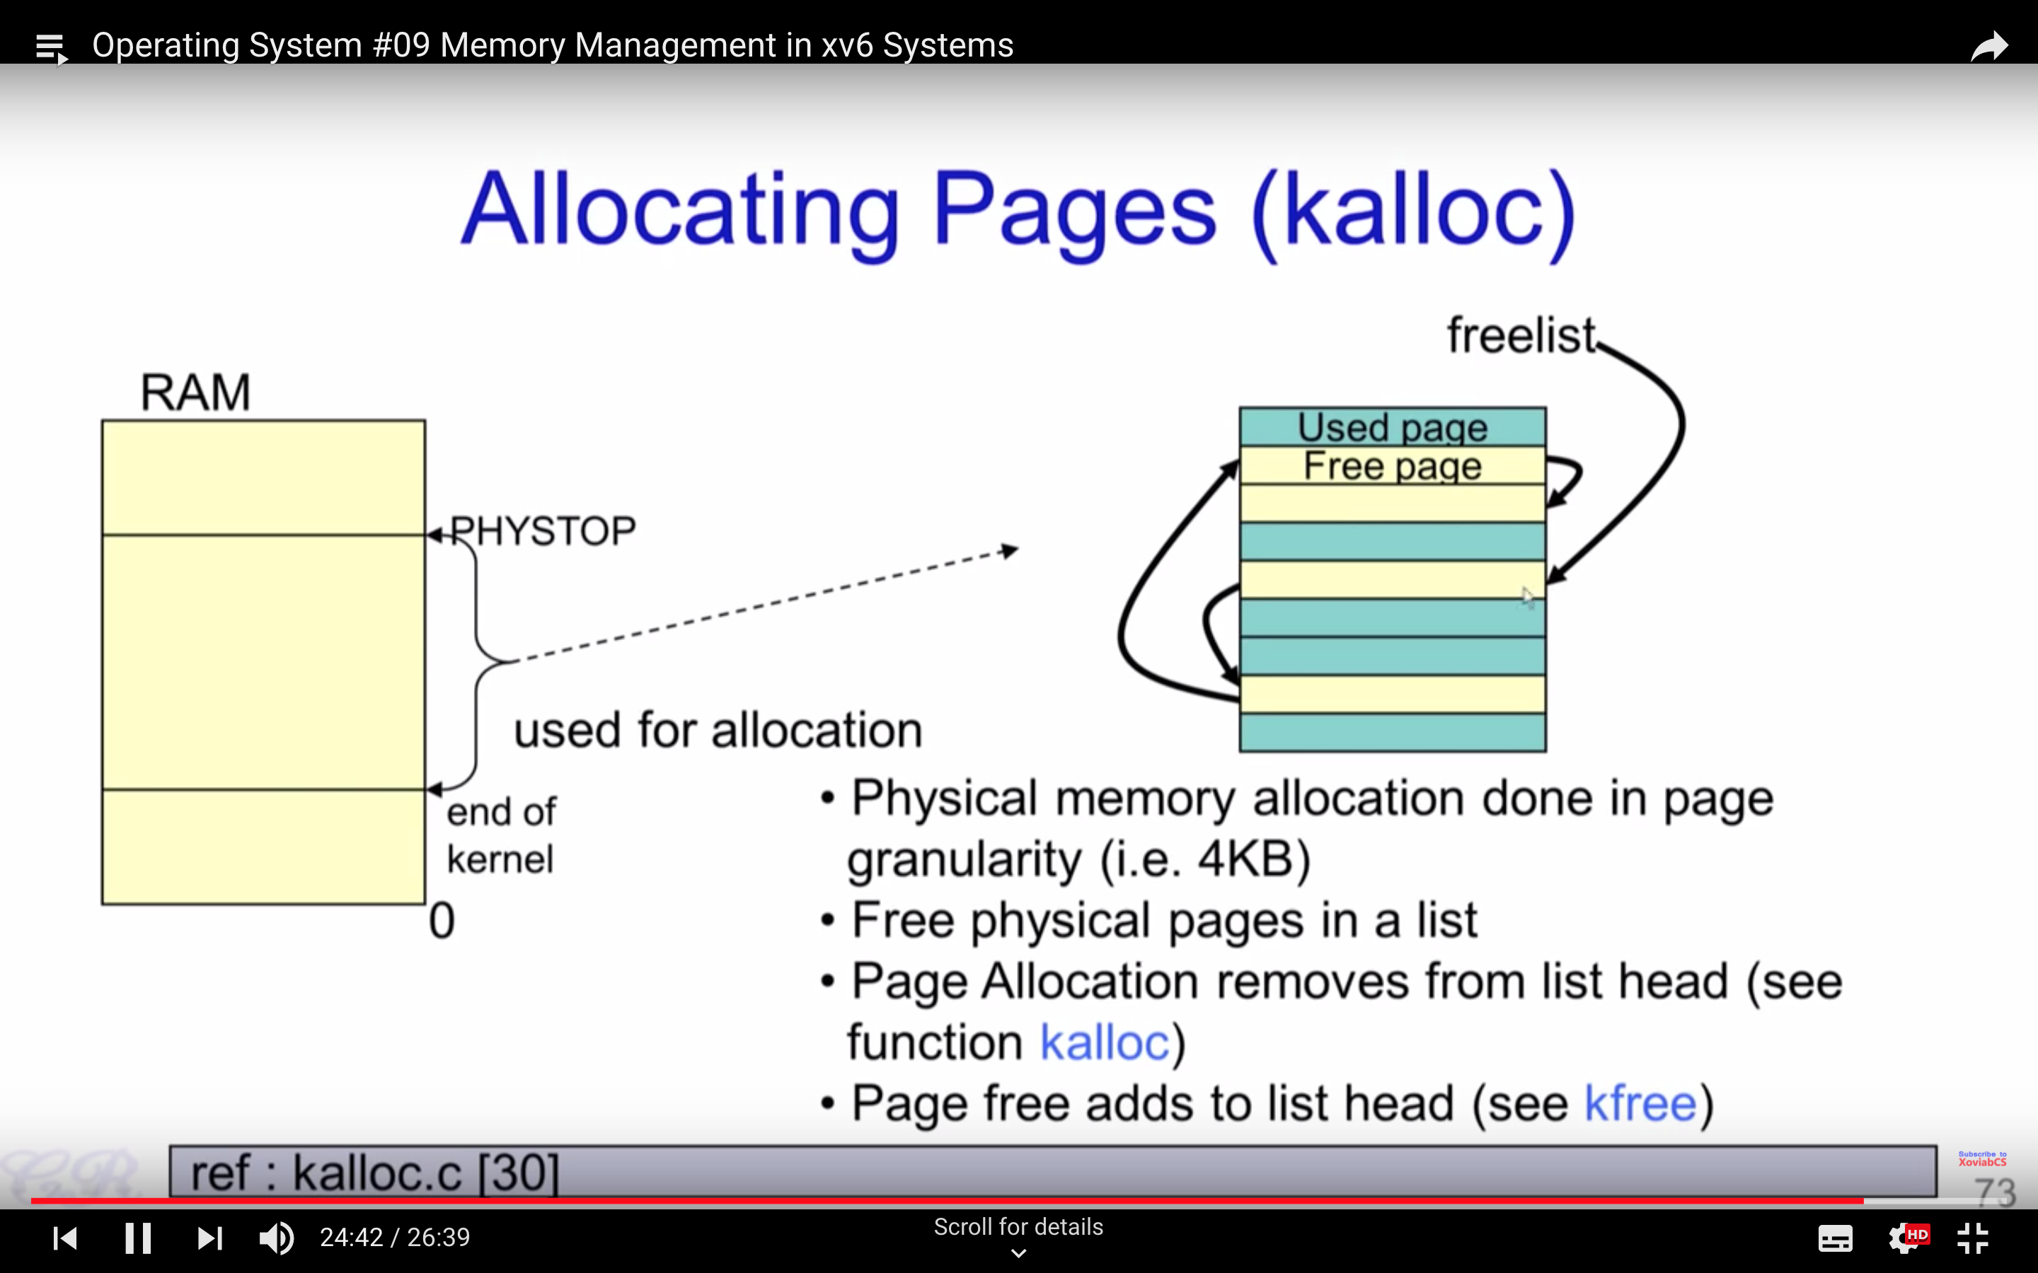

Slide 57
